Slide 1
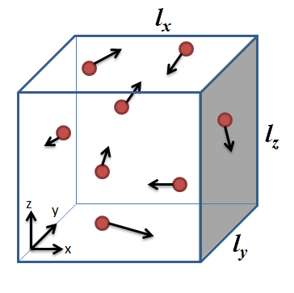
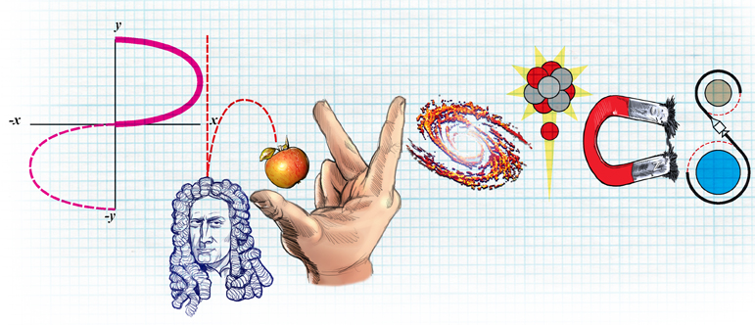
A level Physics
A level Physics gives you the opportunity to explore the phenomena of the universe and to look at theories that explain what is observed. This subject combines practical skills with theoretical ideas to develop descriptions of the physical universe..
Studying A level Physics can lead to careers in engineering, industry, transport, astronomy, robotics, government, universities, the armed forces, the secret service, games companies, research labs and more.
A Level Physics is a facilitating subject commonly asked for in university entry requirements.
Physics is closely linked to Maths, studying the two together can improve your skills in both.
A level Physics results are consistently very strong.
The course is delivered by experienced, supportive teachers.
CAN I STUDY A LEVEL PHYSICS?
Grade 6 GCSE Physics or 6-6 in GCSE Combined Science is required.
If you are consistently working at this grade or above, you should consider PHYSICS.

