Slide 1


GCSE Religion Philosophy and Ethics allows students to demonstrate their ability to:
Apply knowledge and understanding of two religions;
Understand the influence of religion on individuals, communities and societies;
Understand significant common and divergent views between and/or within religions and beliefs;
Construct well-informed and balanced arguments on matters concerned with religious beliefs and values.
Why do GCSE candidates choose Religious Studies?
“I like to learn about controversial issues.”
“I get to discuss moral issues and there are no wrong opinions.”
“I enjoy expressing my views and opinions and listen to the views of others.”

Slide 2
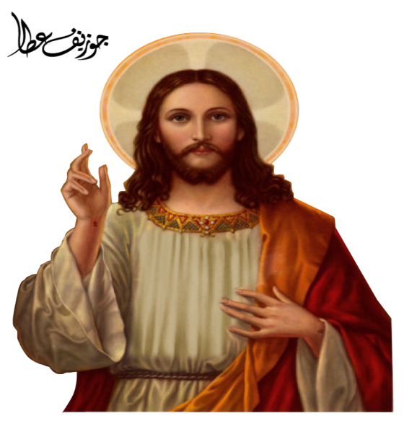
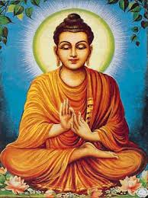

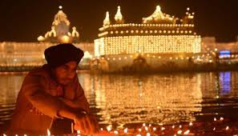
What do you study?
Ethics
Philosophy
Relationships and families
Religion and life
Peace and conflict
Crime and punishment
What do Christians, Buddhists believe?

Slide 3
How am I examined?
Two 1hr 45 papers.
Paper 1 – Beliefs and practises of Christianity and Buddhism
Paper 2 – Themes paper. Questions on the four themes you have studied, Families, Religion and life, Crime and punishment, Peace and conflict. You will discuss the different approaches Christianity and Buddhism have to these issues, as well as discussing your own opinions on these issues.

Slide 4
Where can RPE GCSE take me?
A whole diverse ranger of careers from Social work, Social care, Law, Armed Forces, Education, and Medicine to name but a few.

