Slide 1
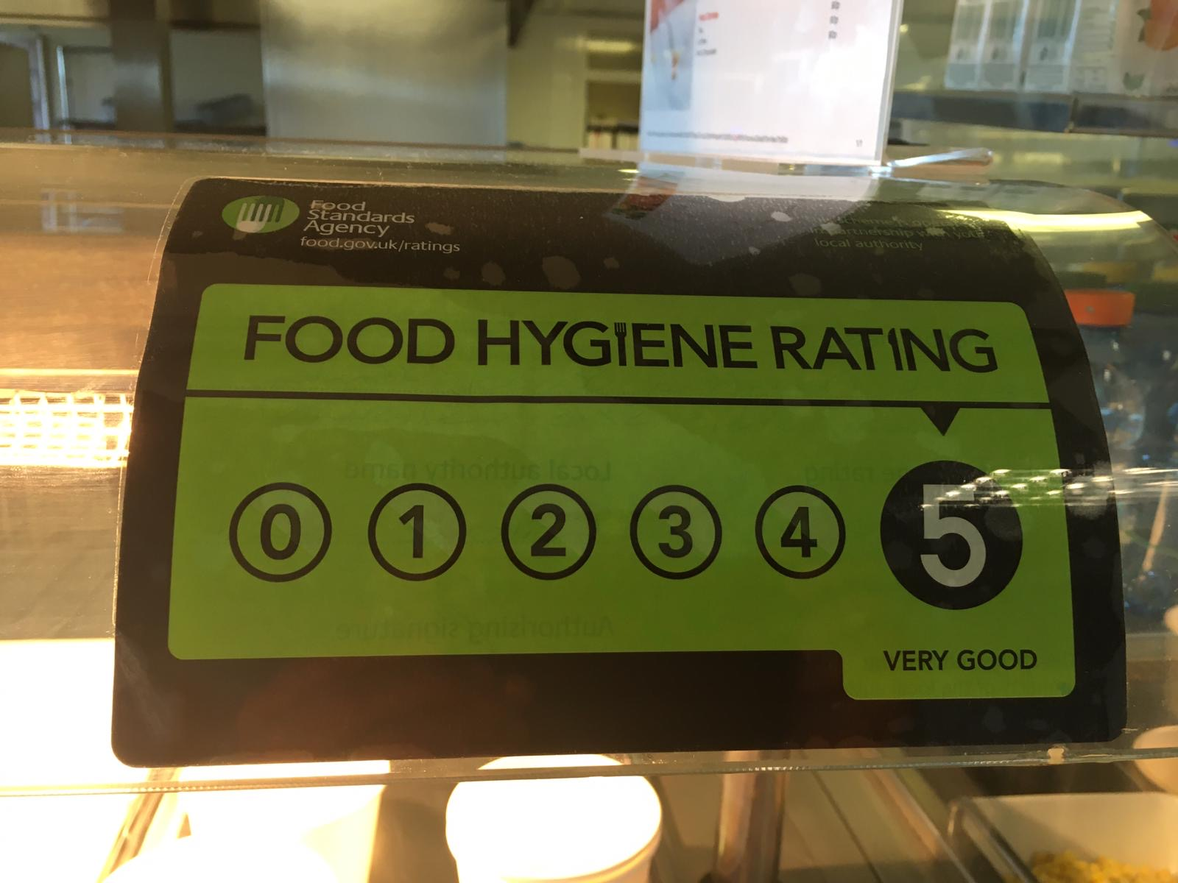
G4S are delighted to provide the catering at Abbeyfield, we have a wonderful selection of nutritious food available, whilst ensuring its delivered with an industry leading food safety system, by our friendly trained team.
Provided by

Slide 2
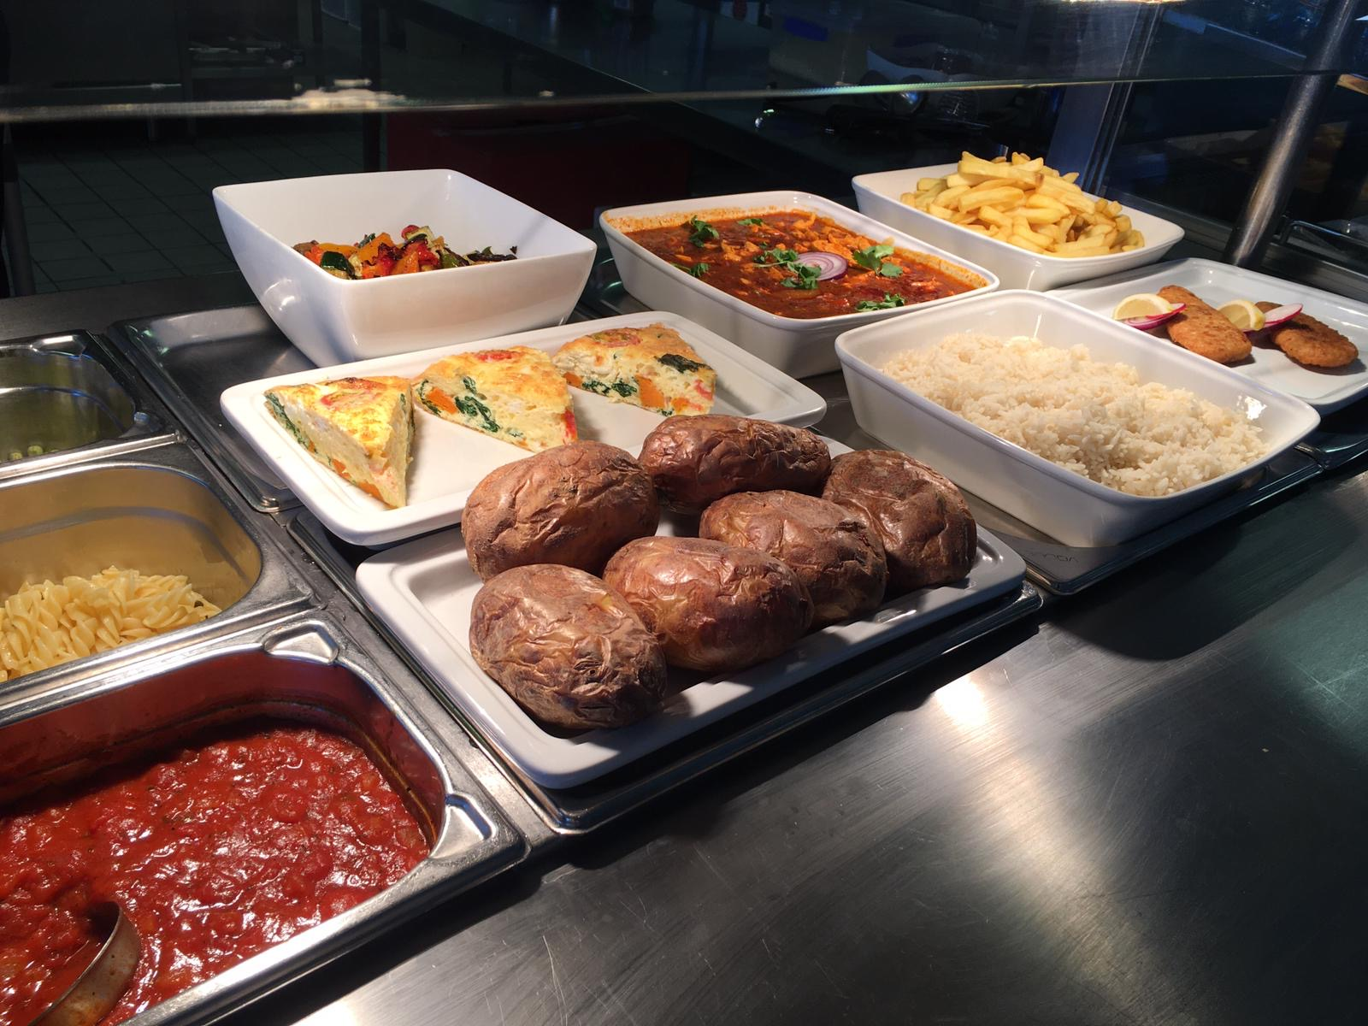
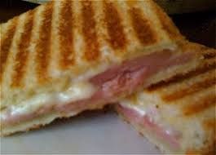
From Panini’s to Jackets and an array of other exciting freshly cooked hot food. All at very affordable prices
available on offer daily!

Slide 3
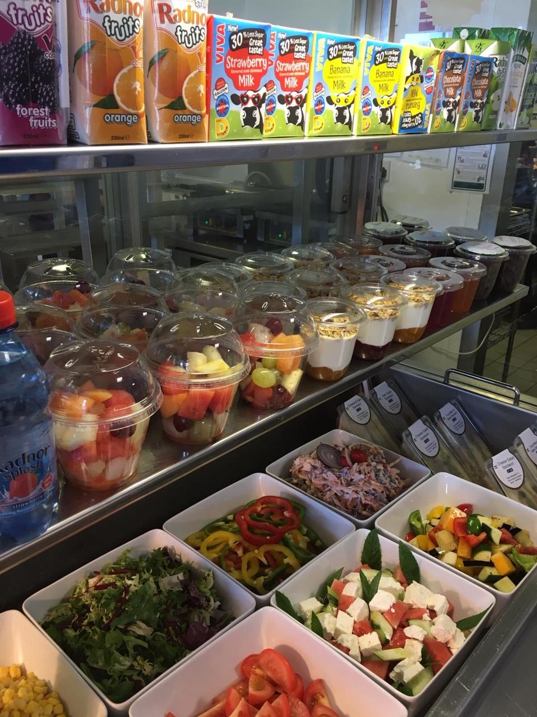
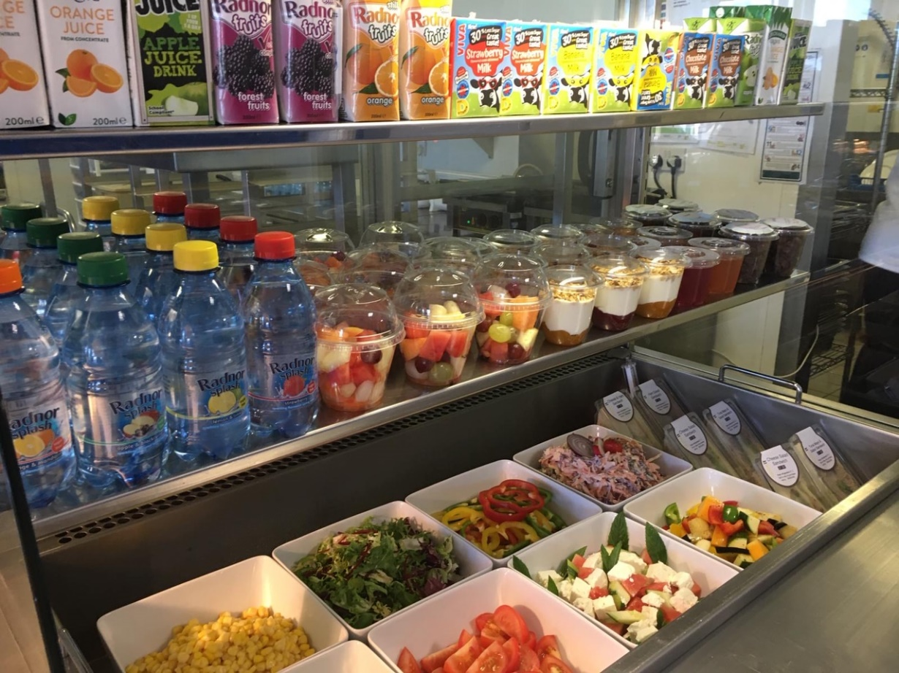
To promote your child’s 5 a
day intake, fresh fruit &
exciting salads alongside nutritious wraps & baguettes available every day!

Slide 4
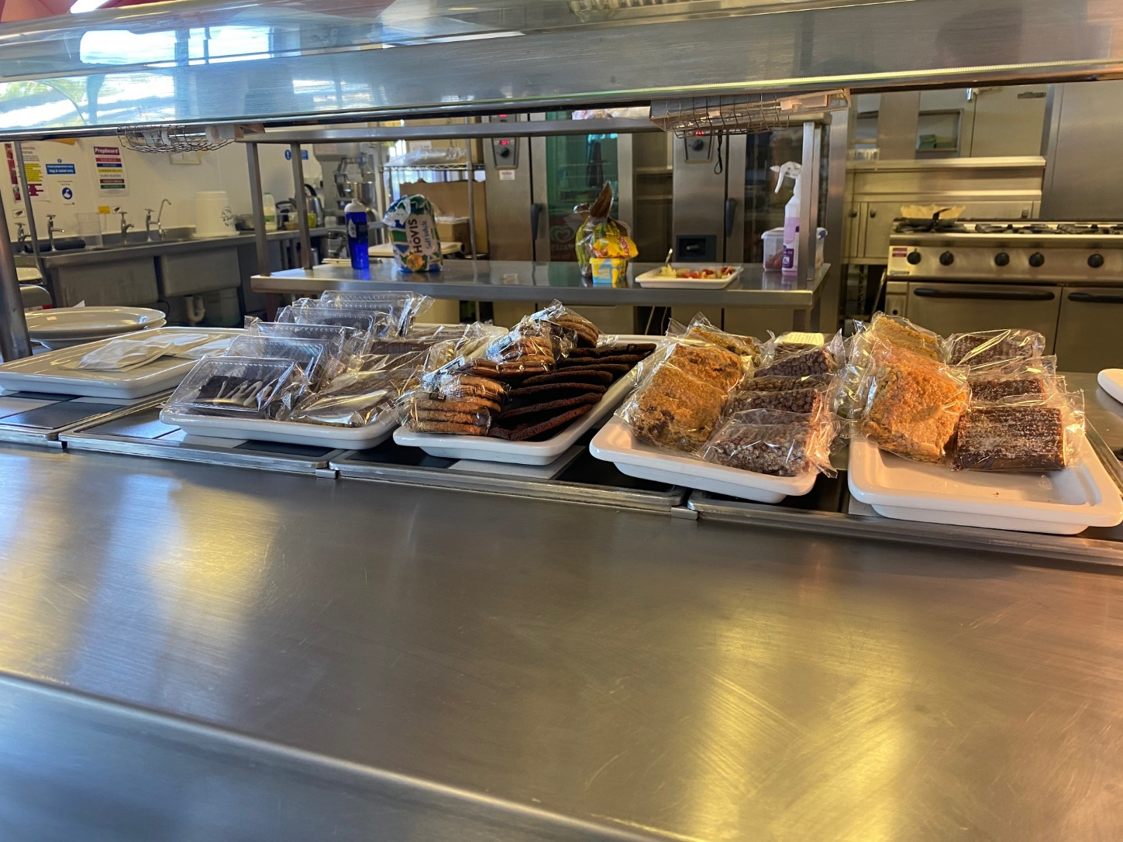
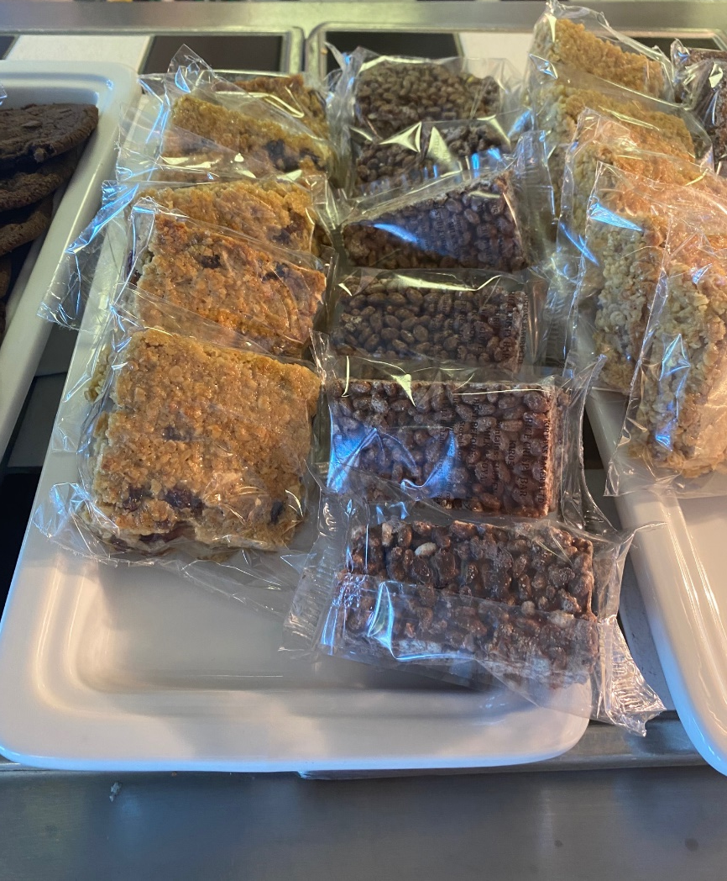
Wide selection of healthy snacks and puddings!
Promoting a menu that is balanced.
A small treat alongside our main
course options

Slide 5
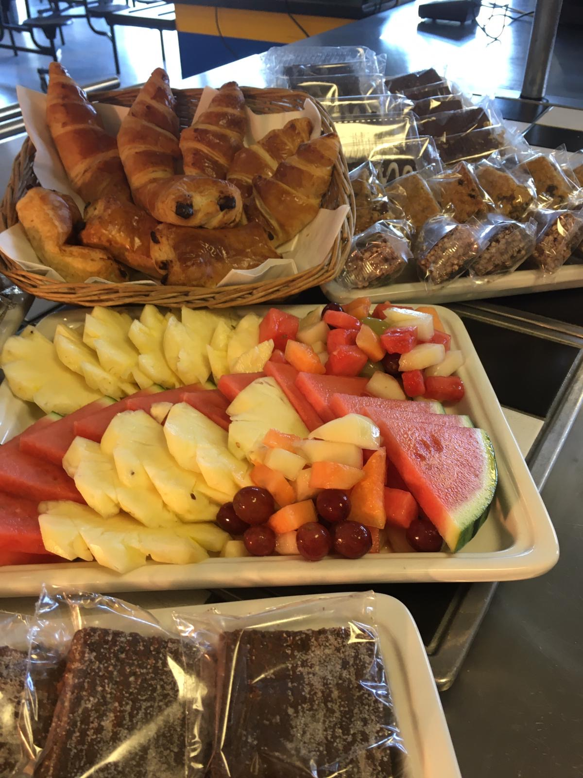
Vibrant, colourful and fresh to encourage healthy choices!!

Slide 6
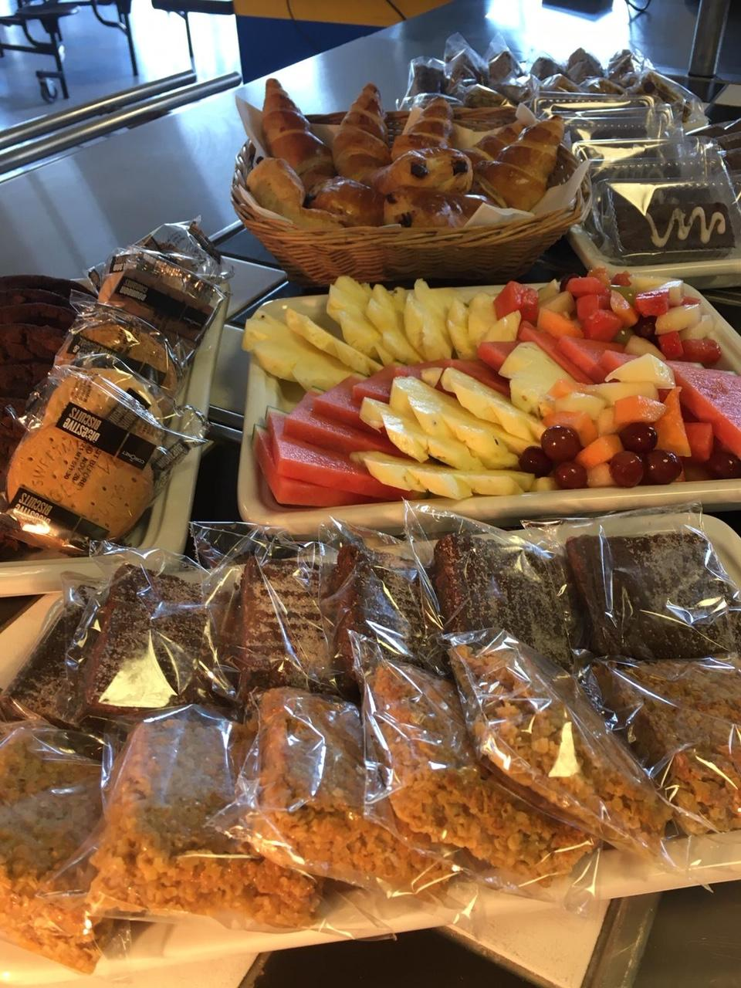
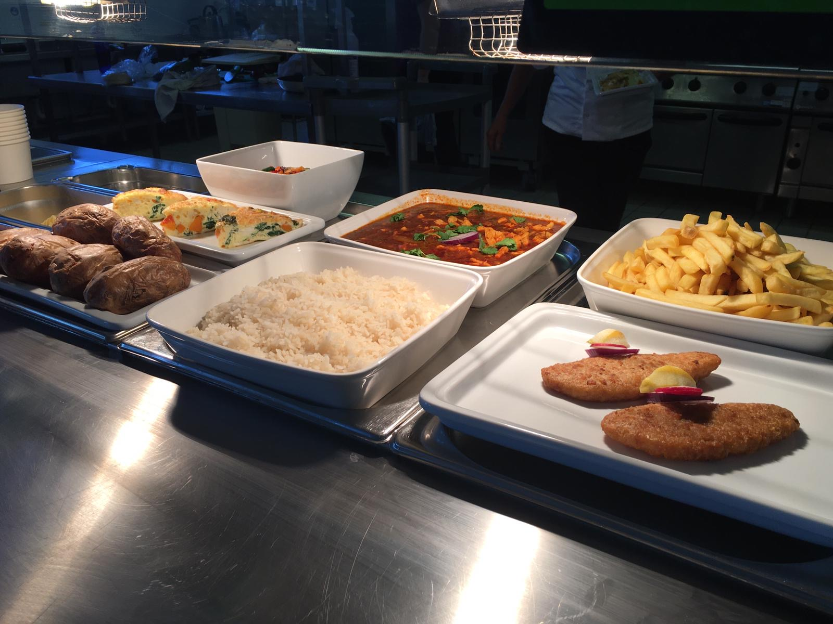
Our friendly & welcoming canteen staff will cater and nurture your child's every need…..

Slide 7
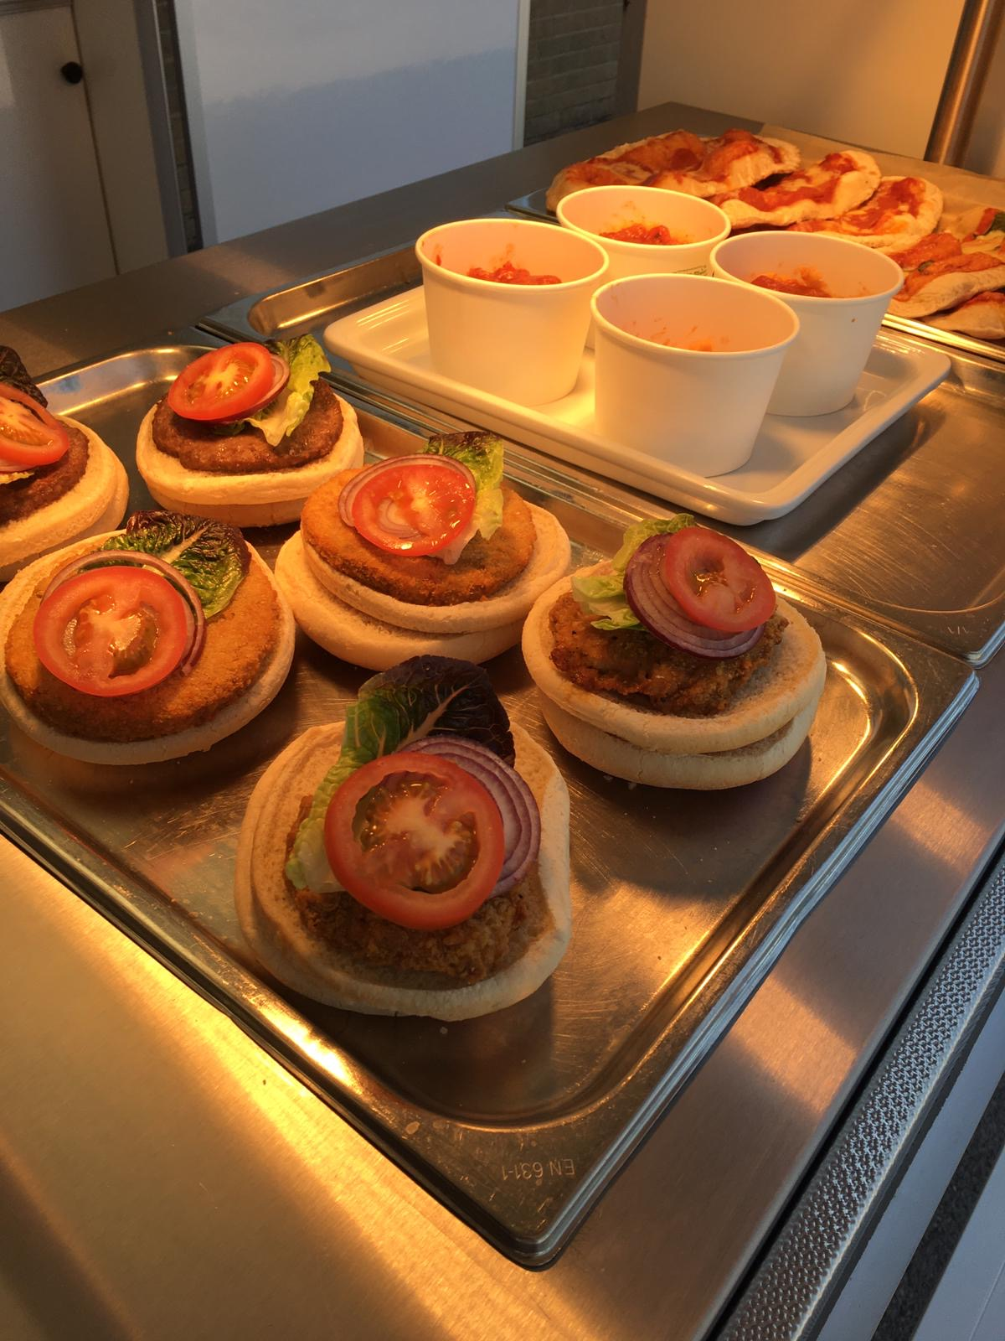
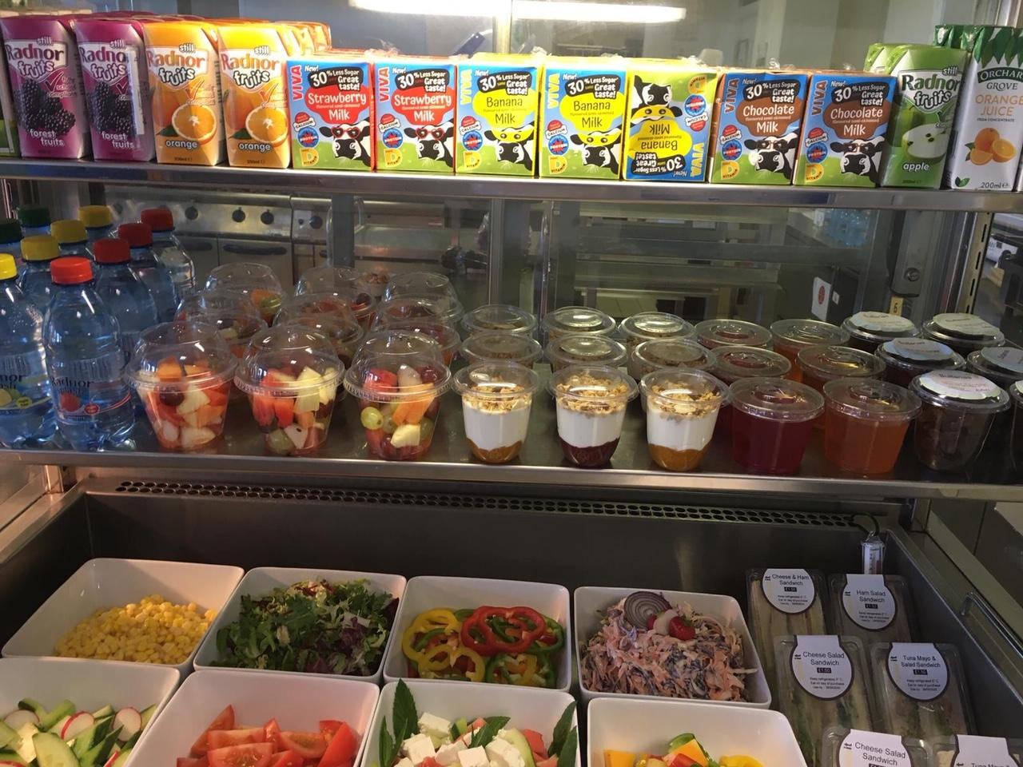
Promoting seasonal menu changes to keep the offer
fresh and varied, alongside low sugar hot and cold
drinks and all day items like granola breakfast yoghurt pots there is a healthy and popular offer for the whole school day

Slide 8
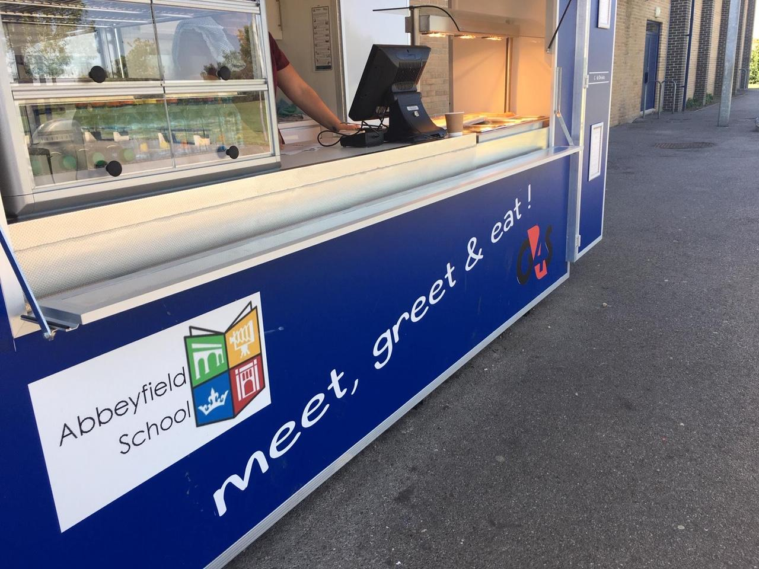
More outside facilities...
A grab and go service point with sheltered seating area, for children on the go.
All till point made quick and easy for parents with a cashless Parentpay system.

