Slide 1
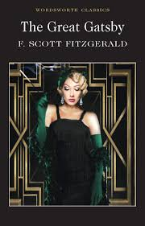
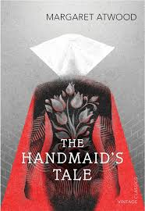
A Level Literature
Why should you choose an A level in English Literature?
Top universities see it as a prestigious and facilitating qualification.
A Level Lit gives you transferable skills, such as perfect essay writing; an ability to create a clear line of argument; an understanding of human beings and the world…
It is a gateway for many potential careers, such as Journalism of all sorts, the media – television, the film industry. Publishing, Advertising and Marketing, Copywriting,
Law, Business, public sector, education… and anywhere where communication is key.
The course is taught by Literature specialists, with great enthusiasm and knowledge. We love our subject!
It links well with Philosophy, Psychology, History, English Language, Art, Law and more…
Which qualifications will I need to study English Lit? You will need a 5 in either Literature or Language at GCSE – ideally both!

