Slide 1
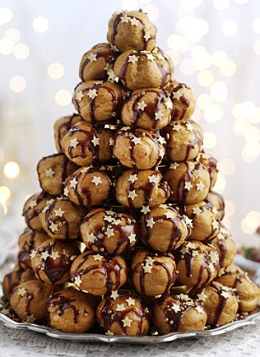
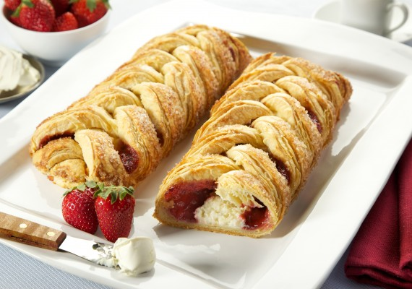
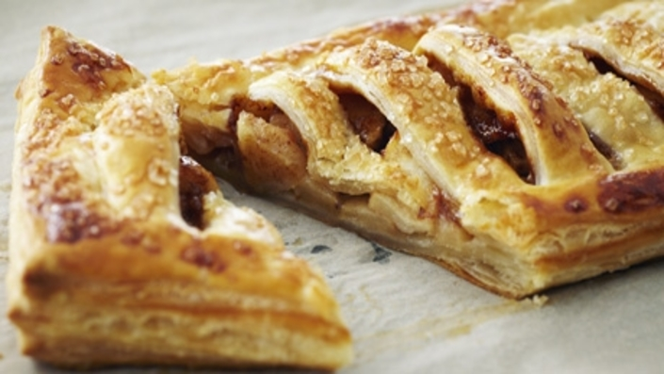
Hospitality and Catering Level 1/2
September 2021

Slide 2
Components:
Unit 1 : Exam Summer Term Year 10 (40%) . Contents to include:
The industry
Working conditions
Providers and how these vary from takeaway to high end restaurants
Running a kitchen
Front of house
Meeting the customer needs
Looking after employees
Food safety including awareness of allergies
Legislation
Environmental health officers Retakes Jan in Year 11

Slide 3
Unit 2 Hospitality and Catering in action (60%)
This unit starts in September of Year 11
The unit is based around a brief from the exam board and is mixture of both detailed research and practical opportunities
Expectations are that elements learnt in Unit 1 are demonstrated in Unit 2 e.g. Food safety using the correct equipment, correct chopping boards, awareness of how to present work to a high standard
Trial tests in December and final choices in February
Final submission of work end of Term 4
Work submitted weekly to ensure all are on track

Slide 4
How do lessons work out ???
Expectations:
Weekly input on theory and practical tasks to support understanding
Weekly practical lessons to develop skills – aiming to develop high level skills to ensure the maximum number of marks
Regular class work and homework will be set
Throughout Year 10 there is an expectation that students
will take notes to support their revision at the end of
Year 10
Expectations that practical will be completed weekly

Slide 5
Outcomes
A career in hospitality and catering
A qualification to build upon
Support casual work whist in education
Further questions :
sej@abbeyfield.wilts.sch.uk

