Slide 1
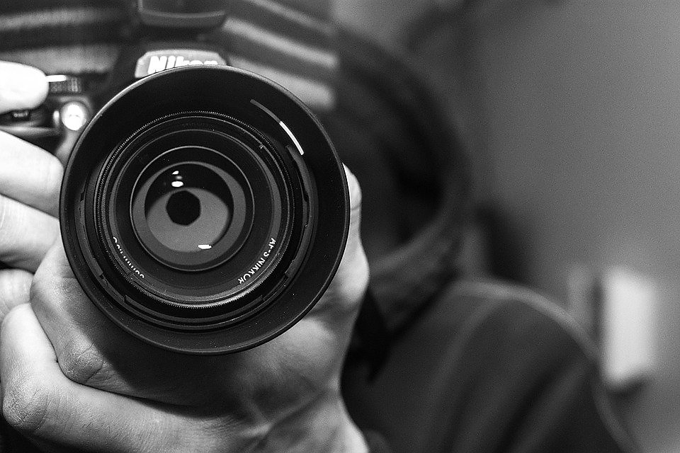

GCSE PHOTOGRAPHY
ABBEYFIELD SCHOOL

Slide 2
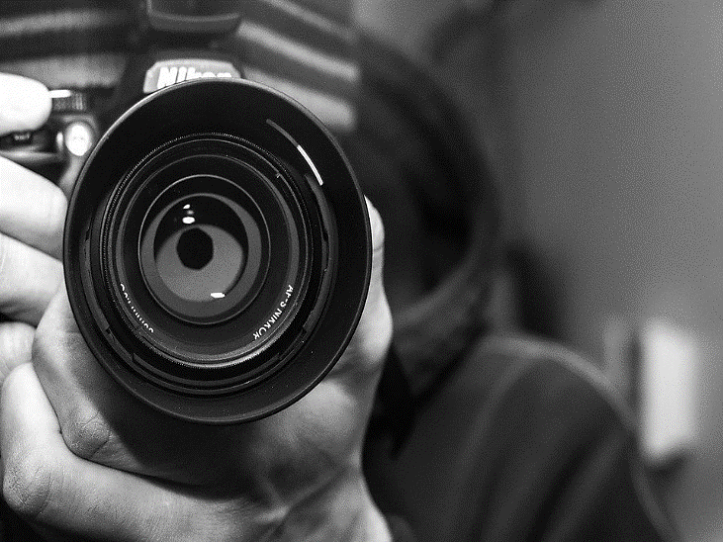
Why Choose GCSE Photography?
Are you creative and imaginative? Do you enjoy exploring ideas and looking at things in different ways? If so, you should consider a course in GCSE Photography. You will enjoy developing your understanding of the visual world, learning practical skills and responding to ideas and issues in ways that are personal to you.
Skills
Within photography, you will demonstrate the ability to:
use photographic techniques and processes, for example:
  lighting
  viewpoint
  aperture
  depth of field
  shutter speed and movement
  use of enlarger
  chemical and/or digital processes
use media and materials, for example:
  film
  photographic papers
  chemicals appropriate to darkroom practices
  digital media, programs and related technologies
  graphic media for purposes such as storyboarding, planning and constructing shoots.

Slide 3

Why Choose GCSE Photography?
Further study and career opportunities
A Level Photography/Graphics
BTEC courses within the visual Arts
Possible degree options
Animation
Commercial Photography
Creative and editorial photography
Digital media
Fashion photography
Film, television and visual culture
Forensic photography
Graphics with photography
Medical photography
Visual communication
Possible career options
Studying a photography related
degree will give you all sorts of
exciting career opportunities, including:
Commercial Photographer
Fashion photographer
Filmmaker
Fine art photographer
Forensic photographer
Medical photographer
Nature photographer
Photographic illustrator
Photographic technician
Teacher
Photojournalist
Picture editor
Researcher
Social photographer
Sports photographer

Slide 4
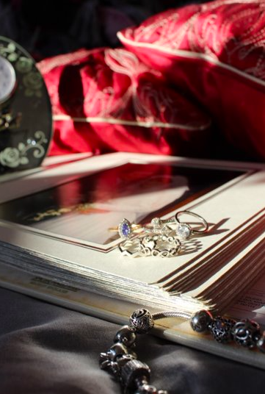
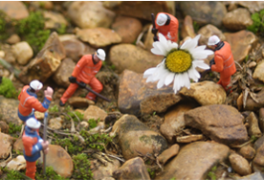
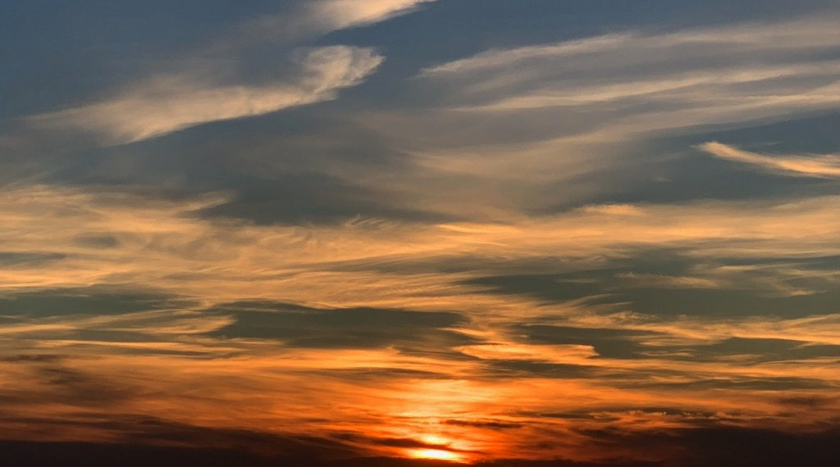
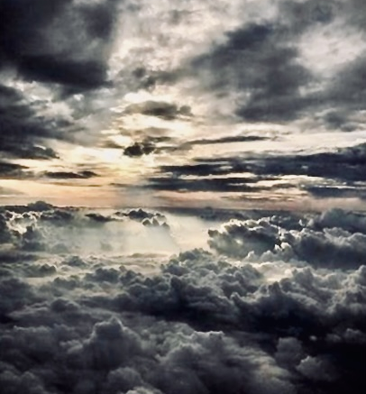
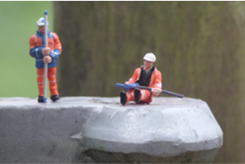
Course Title: | GCSE PHOTOGRAPHY
Exam Board: | AQA
Exam Board Website: | www.aqa.org.uk/subjects/art-and-design
Course weighting: Component 1: Coursework (worth 60% of final grade) Component 2: Externally set assessment (worth 40% of final grade) | You will start producing a ‘portfolio of work’ from year 10 Project themes: Formal Elements Viewpoints and Composition Project title from past exams; Everyday Objects, Detail, Texture You will choose one starting point from a selection of starting points set by the exam board to form a unit of work and produce a final outcome or outcomes in the exam (10 hours - 2 full days)

Slide 5
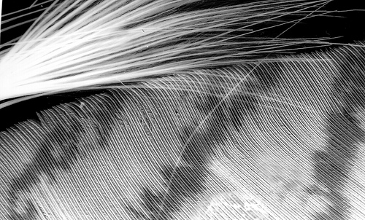
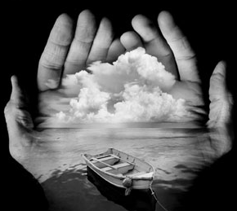
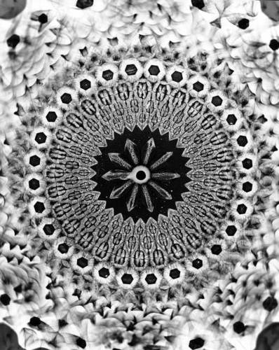
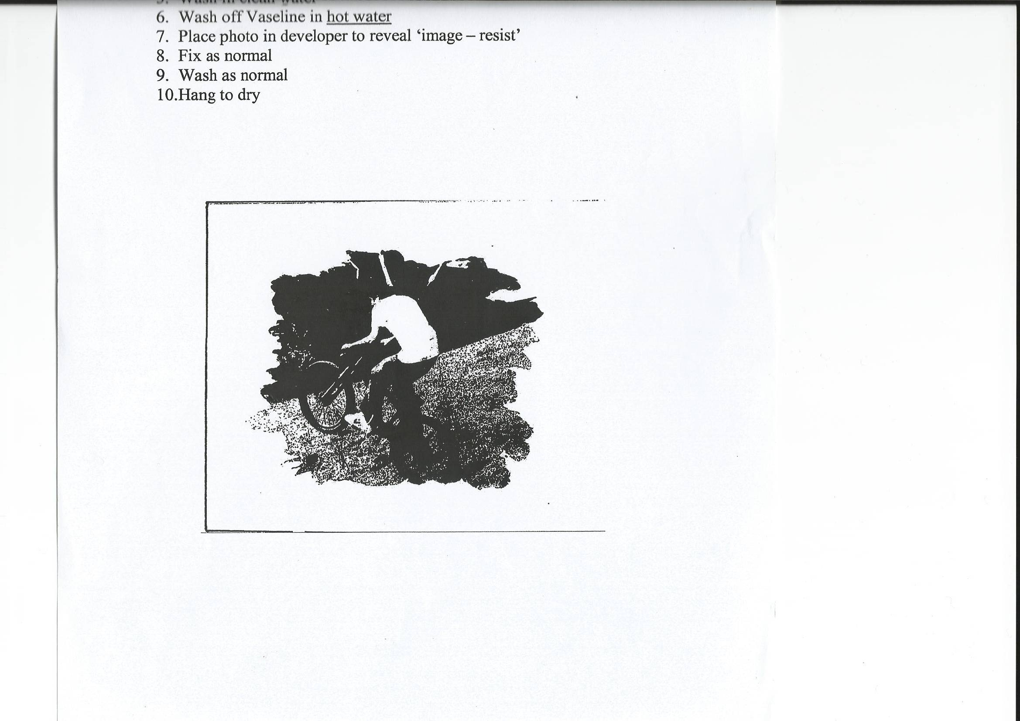
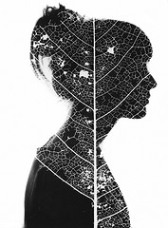
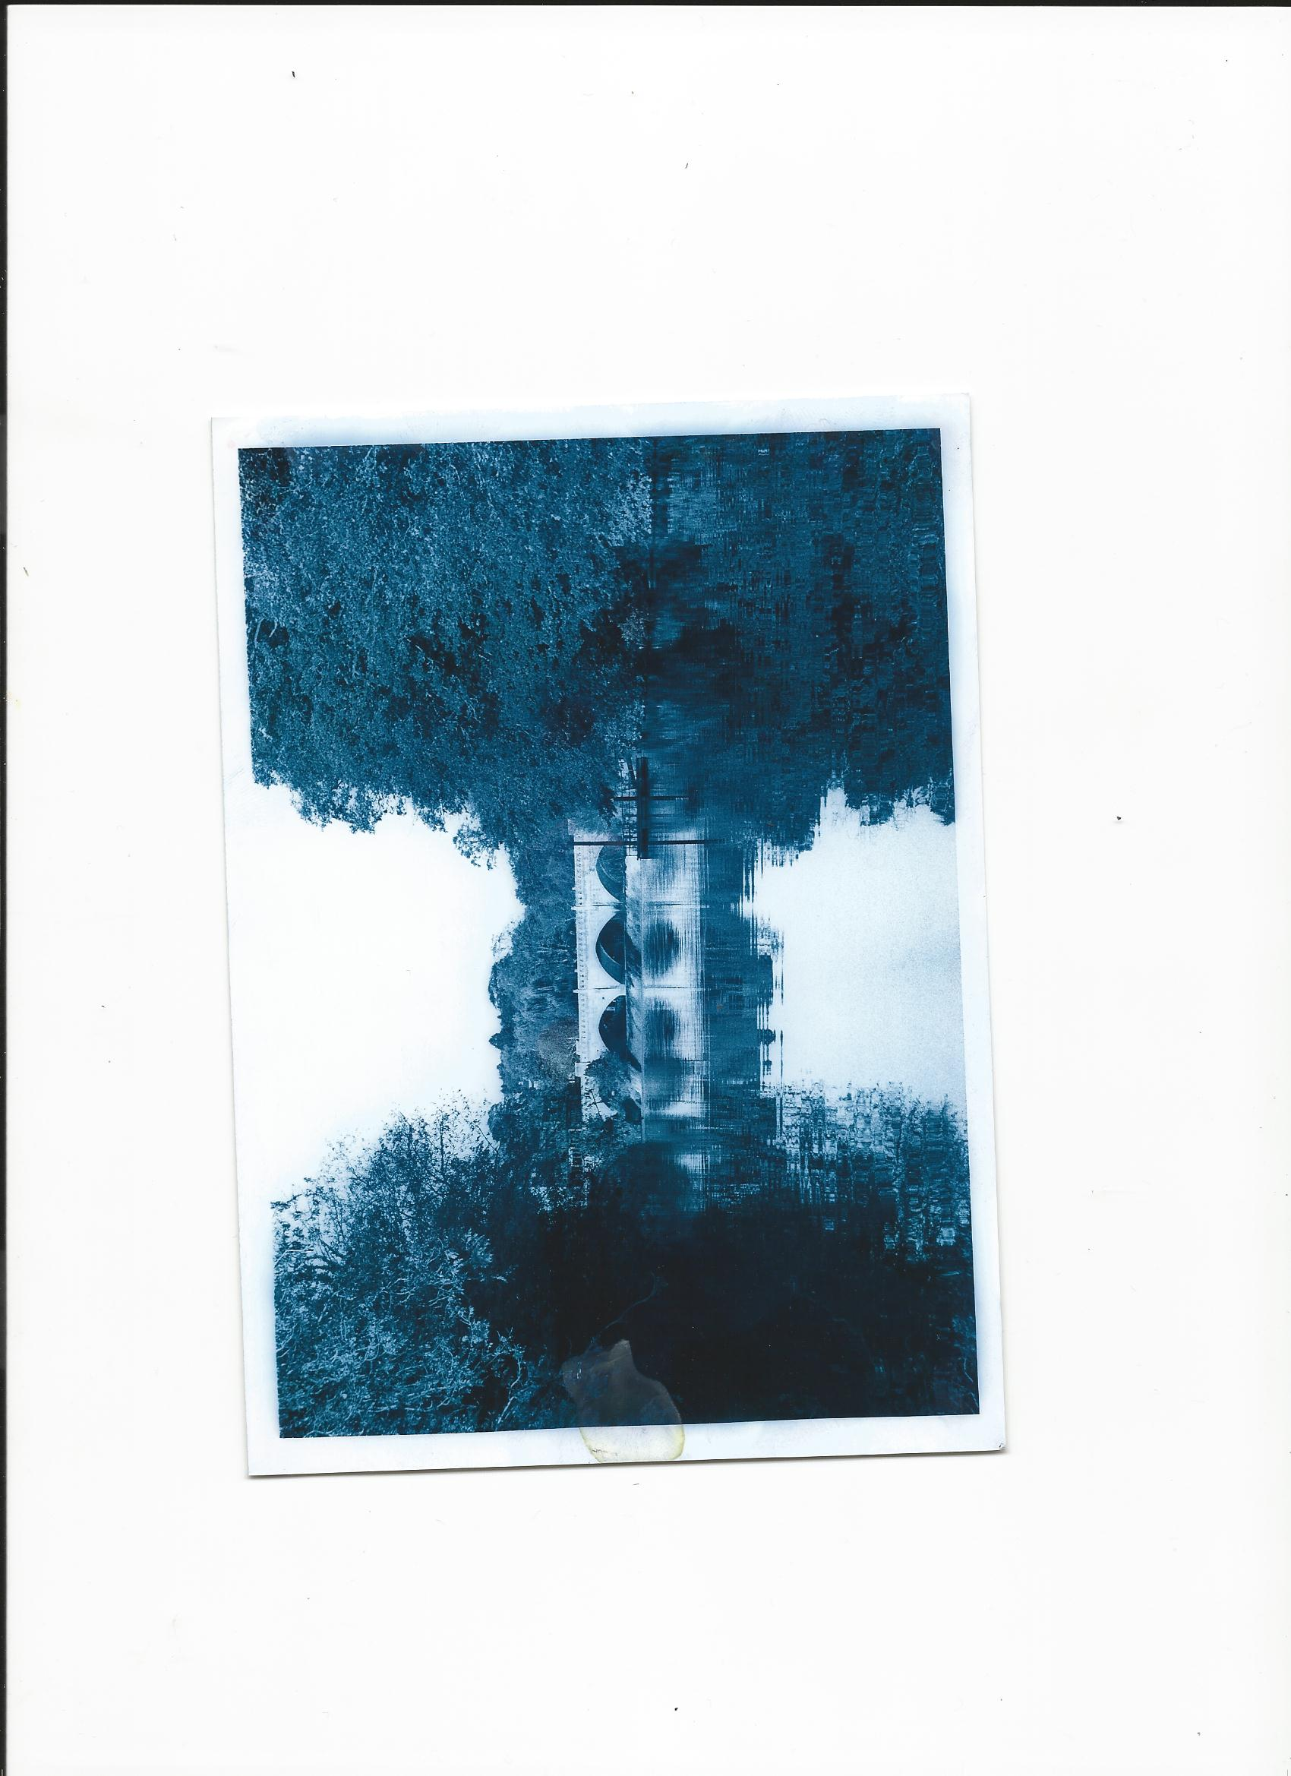
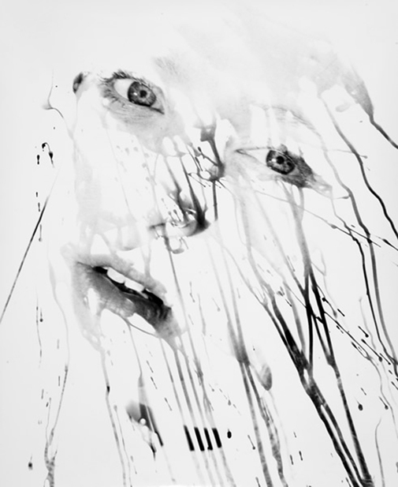
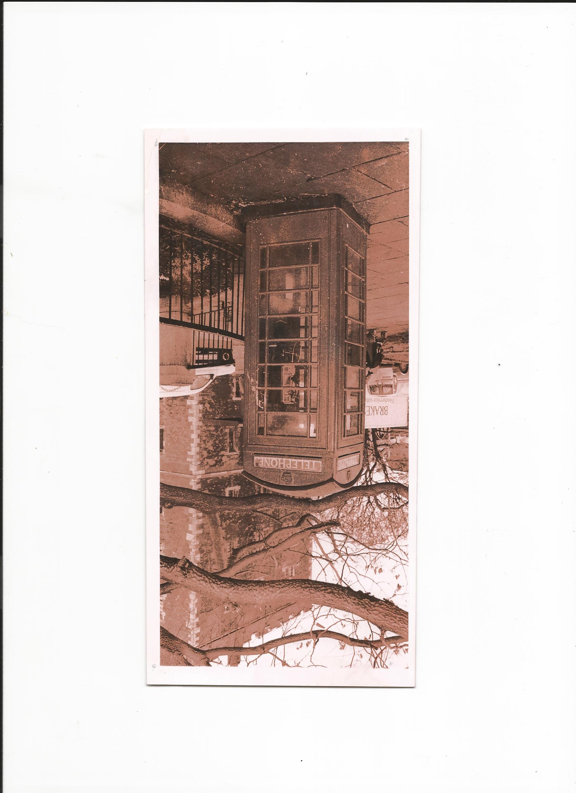
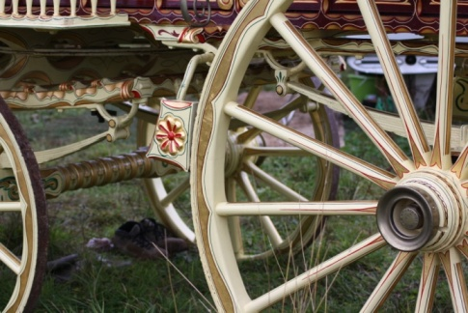
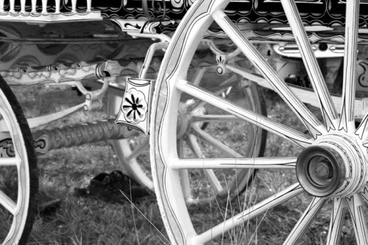
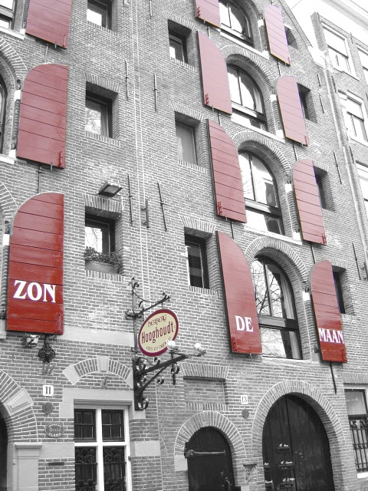
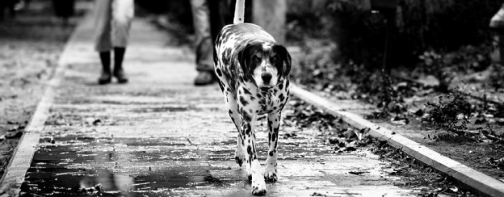
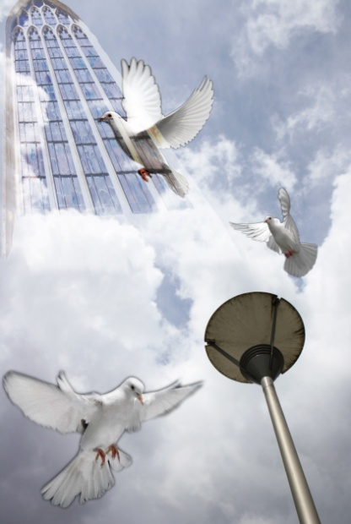
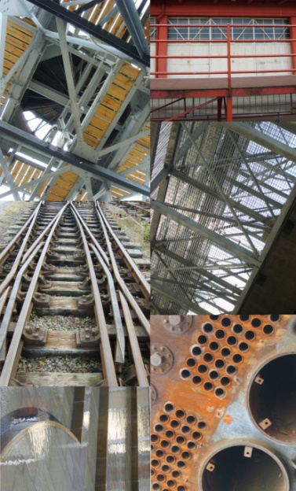
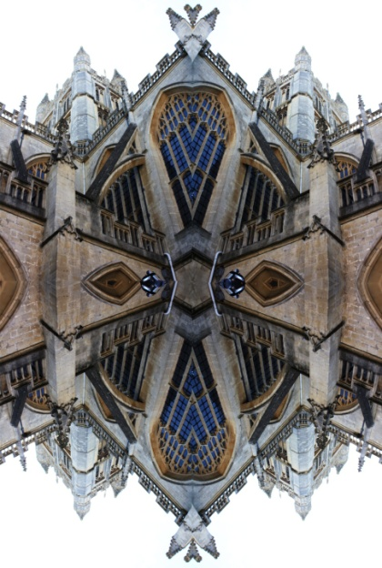
P
Black and White
Photography
GCSE Photography
Component 1:
Portfolio of work
Exploration of digital and analogue photography 60%
Black and White
Photography
Projectogram
Projectogram
Double exposure
Double exposure
Photogram
Photogram
Photobatik
Digital Photography
Colour toning
Photograffiti
Photostencil
Photostencil
Invert to black and white
Cropping
Colour popping
Students develop an understanding and the skills to create photographic images digitally and through dark room processes
Series
Abstract Symmetry
Photomontage

Slide 6
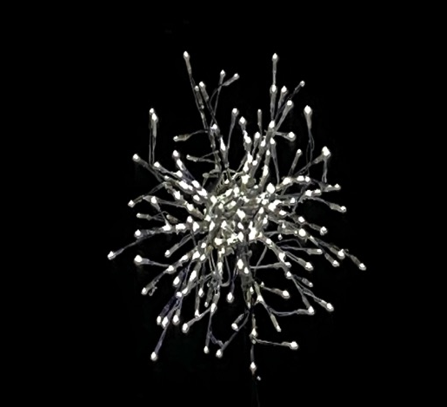
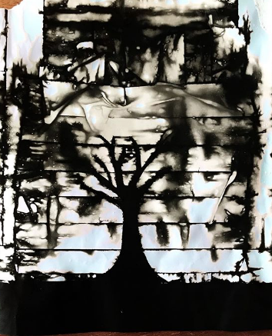
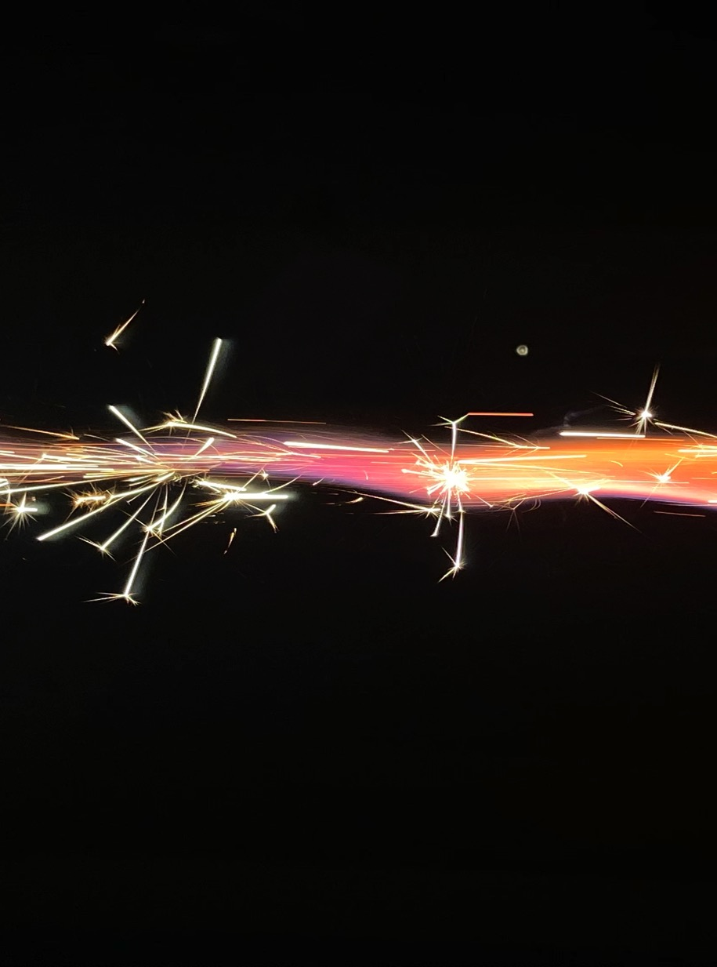
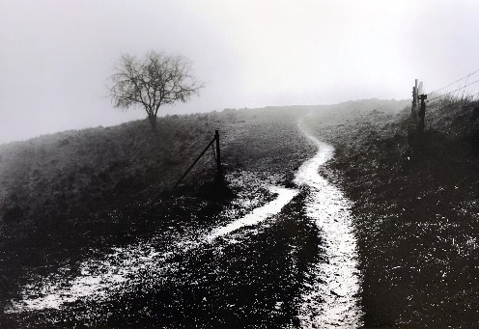
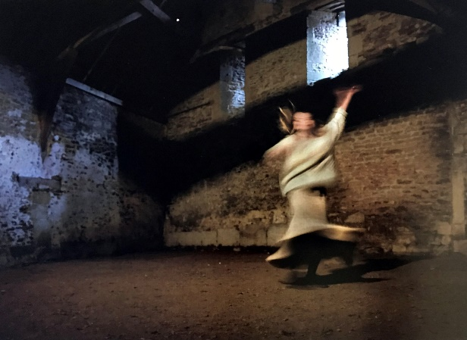
GCSE Photography
Component 2:
Externally Set Assignment
40%
Students are issued from the 1st January with an exam paper.
Choose 1 starting point and respond to that given theme.
Produce a portfolio of work during a period of unlimited time.
Then the students will have 10hrs of supervised time in exam conditions to produce final outcomes/prints.

Slide 7
The work produced will be in response to the
4 Assessment Objectives:
INVESTIGATE, REFINE AND EXPLORE, RECORD, PRESENT.
AO1: | Develop ideas through investigations, demonstrating critical understanding of sources. | Photographer/Artist research and analysis Annotation that makes connections between your own work and that of Photographers/artists
AO2: | Refine work by exploring ideas, selecting and experimenting with appropriate media, materials, techniques and processes. | Exploration of different media and techniques Exploration of different subject matter and themes Annotation that highlight your reflections on your ideas and use of media
AO3: | Record ideas, observations and insights relevant to intentions as work progresses. | Planning of Photo shoots Setting up and taking of photo shoots Manipulation of photographs
AO4: | Present a personal and meaningful response that realises intentions and demonstrates understanding of visual language. | Final outcomes and/or any personal responses Evaluations of outcomes in annotation Connections to research and exploratory work in outcomes

Slide 8

Why Choose GCSE Photography?
Expectations
You will need to be consistent and work hard throughout the whole 2-year course
You will need to be self-motivated
Access to a digital camera beneficial but not
essential
(You can always borrow a camera from school)
There is 1 hour of homework every week

Slide 9
Why Choose GCSE Photography?
In Summary
Why should you do this subject?
If you like taking photographs and would enjoy manipulating them on the computer and experimenting with dark room processes.
If you are creative and like spending your time taking photographs as well as getting out about in different locations.
If you are interested in GCSE Photography and want to know more, contact:
Mrs C Straw cjs @abbeyfield.wilts.sch.uk

