Slide 1
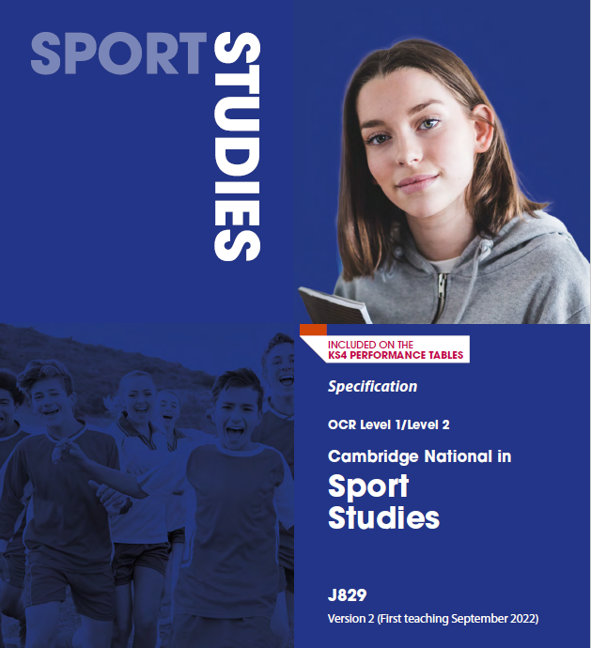
Cambridge National Certificate in Sports Studies

Slide 2
Qualification Overview

Slide 3
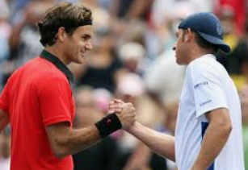
R184: Contemporary issues in sport
By completing this unit you will understand a range of topical and contemporary issues in sport, including learning about participation levels and barriers to completing sporting activities. You will also learn how participation is impacted by the promotion of values and ethical behaviour, about the role of high-profile sporting events, the role of national governing bodies and how technology is used in within sport.

Slide 5
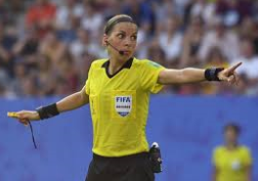
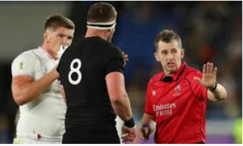
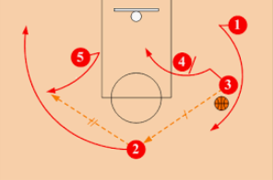
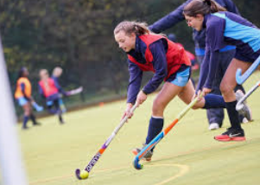
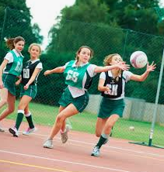
R185: Performance and leadership in sports activities
In this unit you will have an opportunity to develop your skills both as a performer in two different sporting activities, and as a leader. You will work both independently and as part of a team, including communicating with team mates as well as being in front of an audience when you perform. You will perform under pressure, both as a participant and as a leader, and will use your initiative to solve problems and make decisions. Finally, you will deal with rapidly changing conditions and situations.

Slide 6
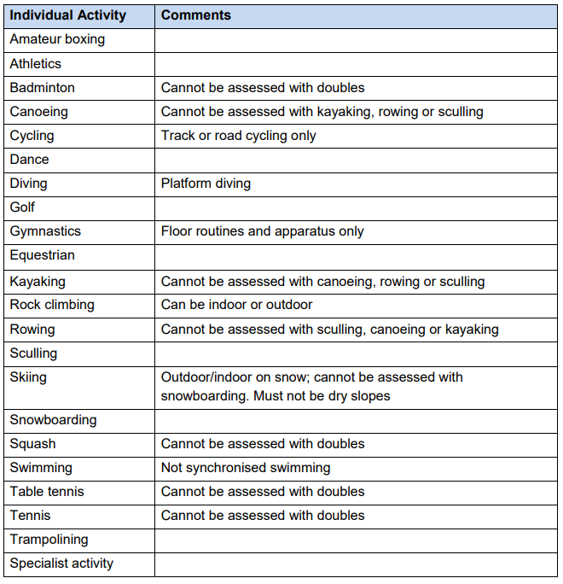
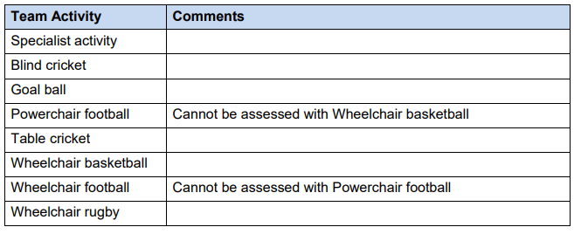

Slide 7
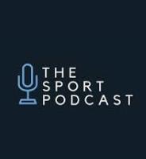
R186: Sports and the media
In this unit you will understand the different sides of a range of media sources and apply real life examples to show the nature of the relationship between media and sport. You will also learn how rapid development in technology is enabling sport to be viewed, replayed and discussed whenever and wherever the spectator wants. You will then develop your ability to evaluate and interpret the different ways in which sport is represented by the media.

Slide 8
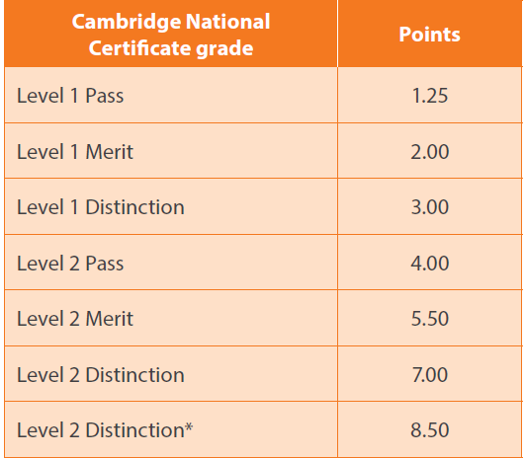
Distinction* at Level 2,
Distinction at Level 2,
Merit at Level 2,
Pass at Level 2,
Distinction at Level 1,
Merit at Level 1,
Pass at Level 1

Slide 9
Why would my child do a Cambridge National rather than a GCSE?
Cambridge Nationals are designed to allow students the freedom to explore more deeply the things that interest them.
The teaching of the qualification will often be through practical work, learning skills and how to do things that may be relevant to the world of work.
A lot of the qualification is assessed by coursework set and marked by your child’s teacher. This will be done throughout the duration of their two year course. So if your child likes project work, enjoys research and doing practical things they may find a Cambridge National a better option than a GCSE.
To ensure the qualification is robust and as stretching as a GCSE, every Cambridge National has an exam. Your child will be assessed through assignment and practical work for two units and an exam at the end of Year 11.

