Slide 1
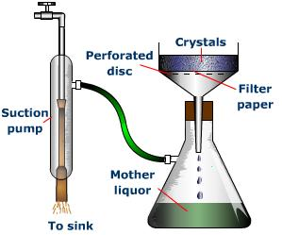
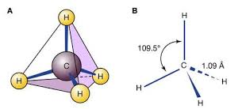
A level Chemistry
Chemistry helps you to develop research, problem solving and analytical skills. It helps to you challenge ideas and show how you worked things out through logic and step-by-step reasoning. and more.
Studying A level Chemistry is an important subject for careers in: medicine, environmental science, engineering, toxicology, metallurgy space exploration, developing perfumes and cosmetics, pharmaceuticals, energy, teaching, science writing, software development and research.
A Level Chemistry is a facilitating subject commonly asked for in university entry requirements.
Through chemistry we have made great discoveries, such as penicillin and pasteurisation, and made the modern world possible with inventions including plastic and lithium ion batteries.
A level Chemistry results are consistently strong.
The course is delivered by experienced, supportive teachers.
CAN I STUDY A LEVEL CHEMISTRY?
Grade 6 GCSE Chemistry or 6-6 in GCSE Combined Science is required.
If you are consistently working at this grade or above, you should consider CHEMISTRY.

