Slide 1
A LEVEL HISTORY
Highly academic and valued; History graduates are amongst the most employable.
Excellent links to other subjects.
Top Universities identify History as a facilitating subject; it teaches you to think critically, analytically and creatively.
History is one of the most relevant subjects you can choose to study.
RESULTS…
Our exam results have been extremely strong since the new A-Levels began. This year for example all students graded, 80% of students achieved A*-C and 60% achieved A*-B.
This year students went on to study at Oxbridge, Warwick and other top universities to study a range of courses from politics to international relations
CAN I STUDY A LEVEL HISTORY?
Entry requirement is Grade 5 either in History if you study it, if not in English. You do NOT need to have done GCSE History, you just need a passion for the subject.

Slide 2
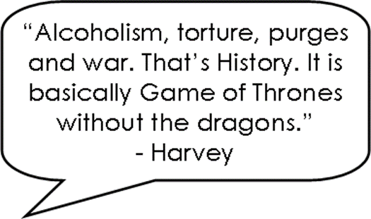
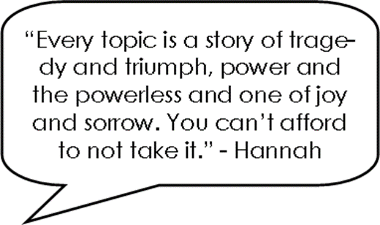
A LEVEL HISTORY

