Slide 1
GCSE FINE ART AT ABBEYFIELD SCHOOL

Slide 2
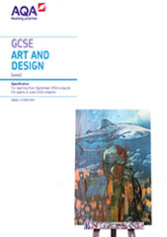
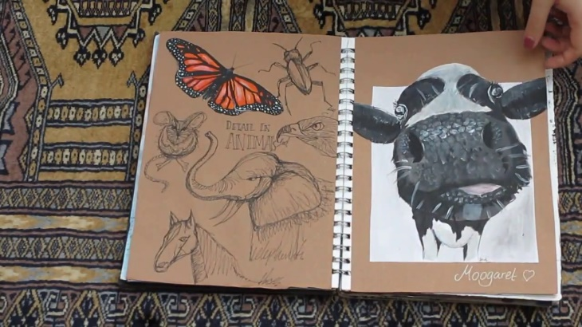
Course Title: | GCSE Fine Art
Exam Board: | AQA
Exam Board Website: | www.aqa.org.uk/subjects/art-and-design
Course weighting: Coursework (worth 60% of final grade) Controlled assessment (worth 40% of final grade) | You will start producing a ‘portfolio of work’ from year 10 – project-based: Food Identity Project title from past exam paper, for example, Expressions You will choose one question from a selection of questions set by the exam board to form a project and produce a final piece in exam conditions (10 hours - 2 full days)

Slide 4
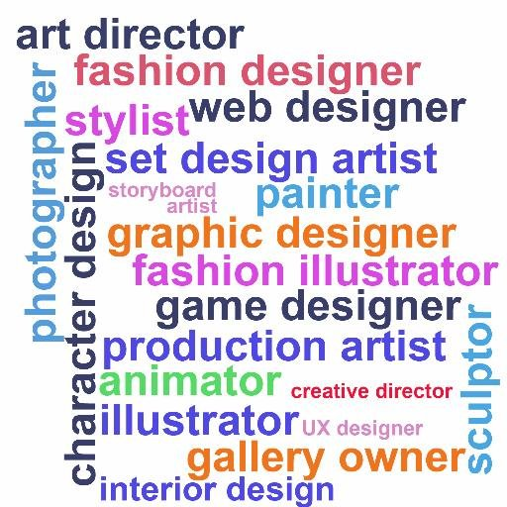

Slide 5
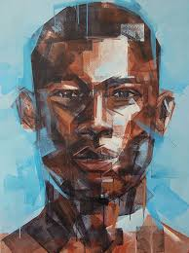
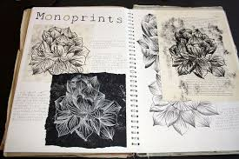
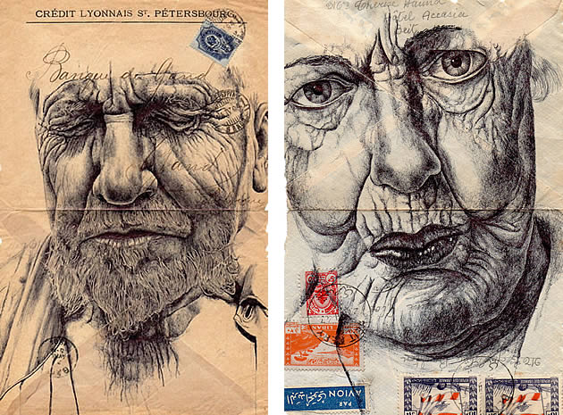
Fine art practice is defined as the need to explore an idea, convey an experience or respond to a theme or issue of personal significance.
Areas of Study…
In Unit 1 (coursework) and unit 2 (exam) you will be required to work in one or more areas of Fine Art, such as those listed below:
· Drawing
· Painting
· Sculpture
· Photography
· Printmaking
· Mixed Media

Slide 6
The work you produce will be in response to the 4 assessment objectives: INVESTIGATE, REFINE AND EXPLORE, RECORD, PRESENT.
AO1: | Develop ideas through investigations, demonstrating critical understanding of sources. | Artist research and analysis Annotation that makes connections between your own work and that of artists
AO2: | Refine work by exploring ideas, selecting and experimenting with appropriate media, materials, techniques and processes. | Exploration of different media and techniques Exploration of different subject matter and themes Annotation that highlight your reflections on your ideas and use of media
AO3: | Record ideas, observations and insights relevant to intentions as work progresses. | Annotation Photography Drawing (particularly working from primary sources)
AO4: | Present a personal and meaningful response that realises intentions and demonstrates understanding of visual language. | Final outcomes and/or any personal responses (not copied) Evaluations of outcomes in annotation Connections to research and exploratory work in outcomes

Slide 7
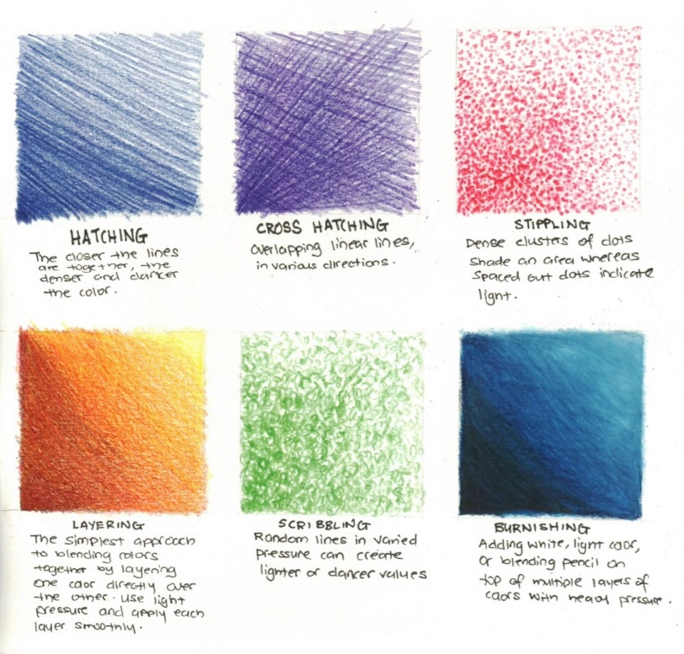
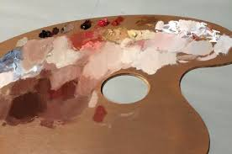
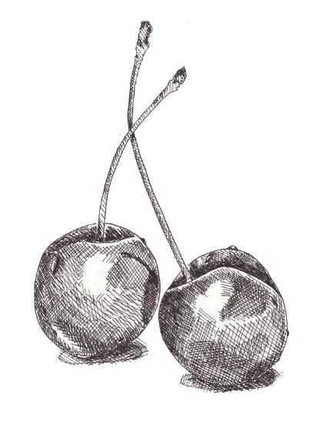
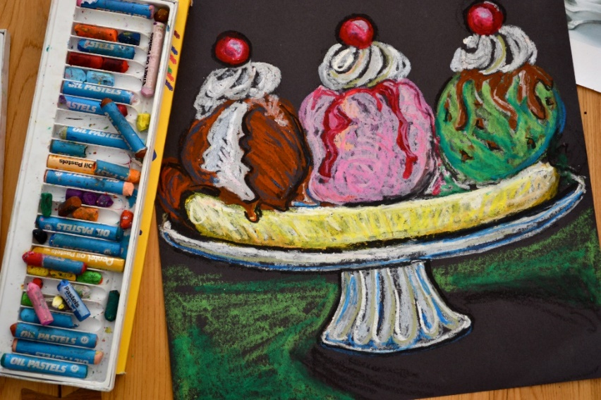
You will learn to use and master a range of art mediums and grow your understanding of the visual elements – the ‘building blocks’ in every piece of art…..

Slide 8
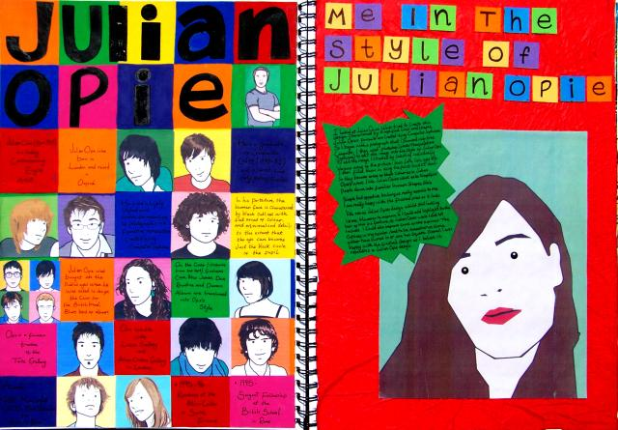
You will look at the work of different artists relevant to the subject matter studying.
You will study their work to find out about how it was made or what meaning is behind it. This research will be in written form and visual studies.

Slide 9
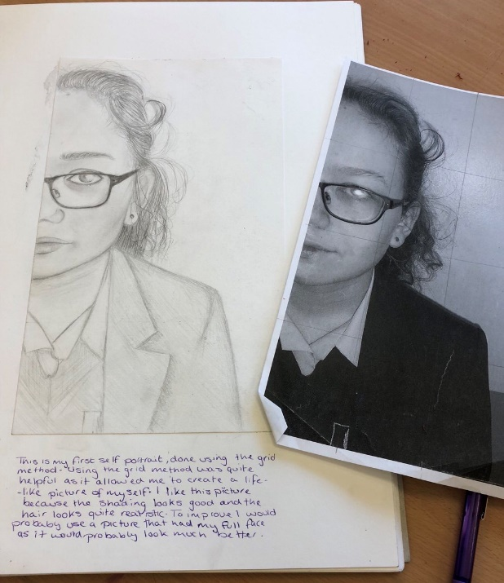
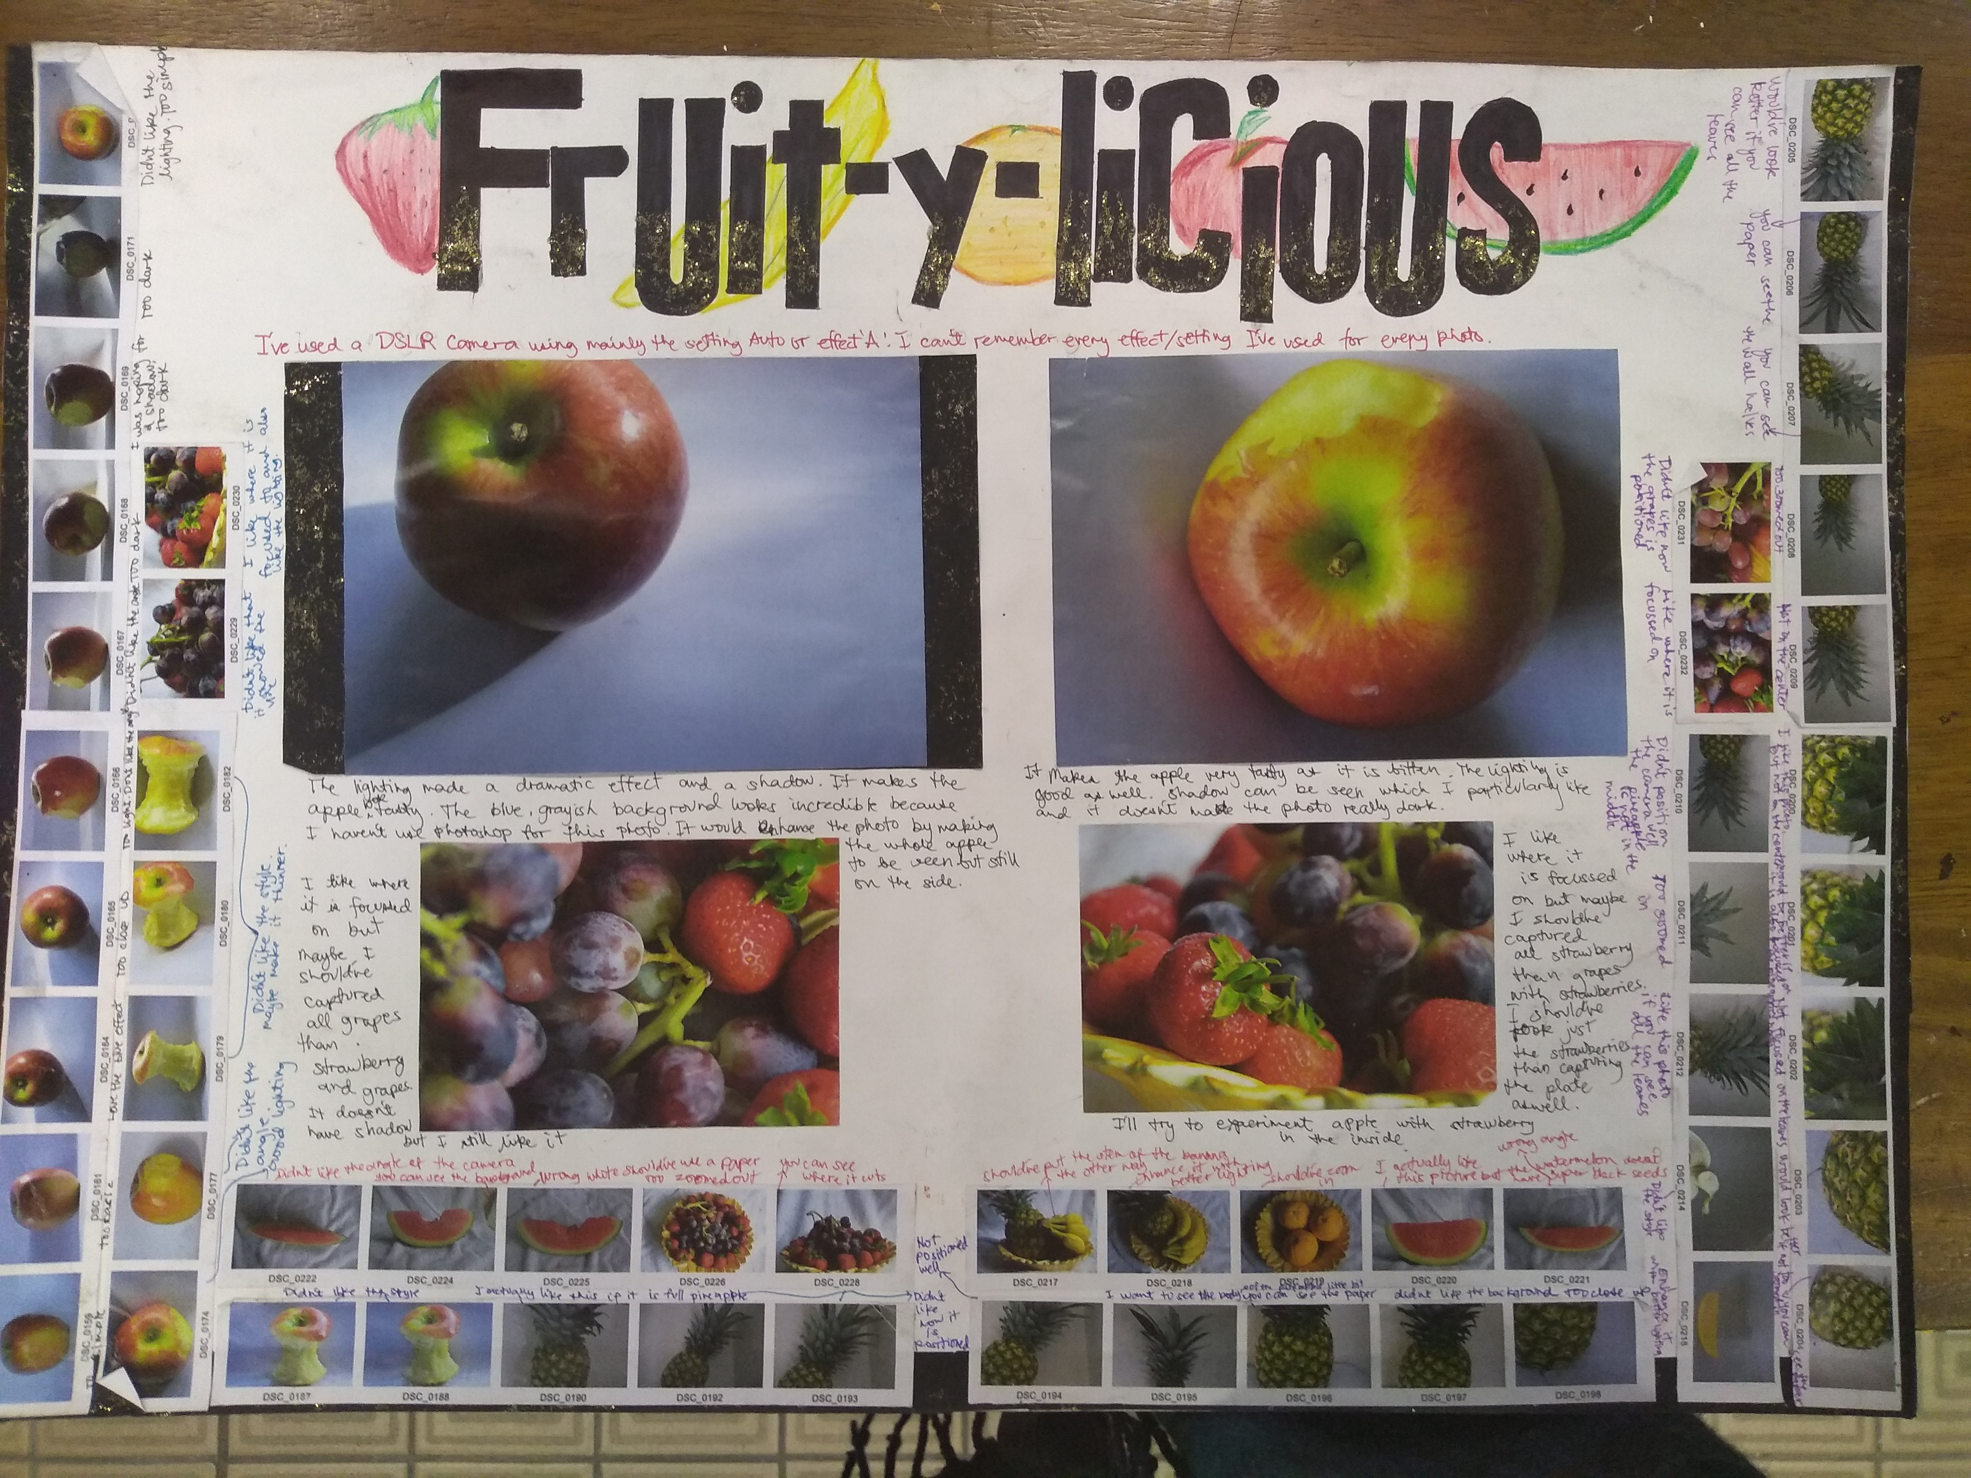
Be prepared to take photos for homework to help you work from when back in the classroom! This primary research is really important for showing that you own the imagery.
Homework is set every 2-3 weeks, with the expected time of 1 hour per week to work on it in order to get quality results. The nature of art can be time-consuming – you will need to be committed to working at home or after-school sessions.

Slide 10
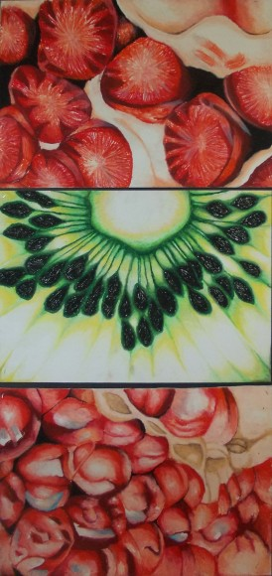
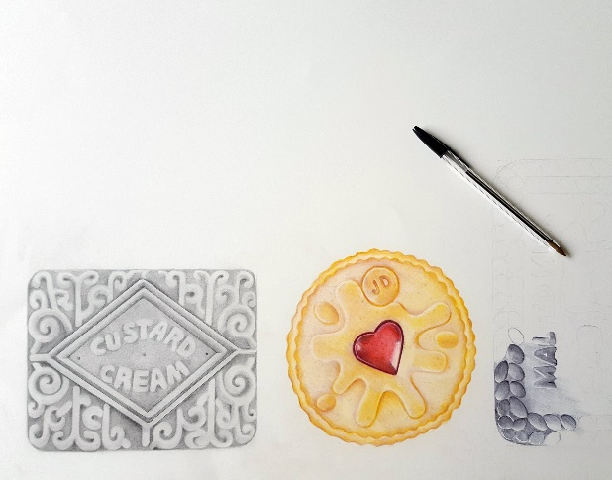
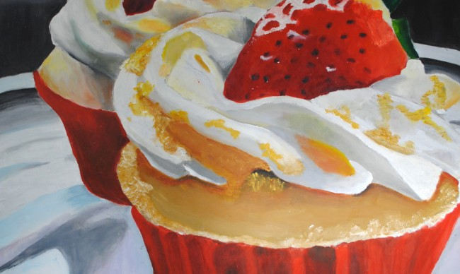
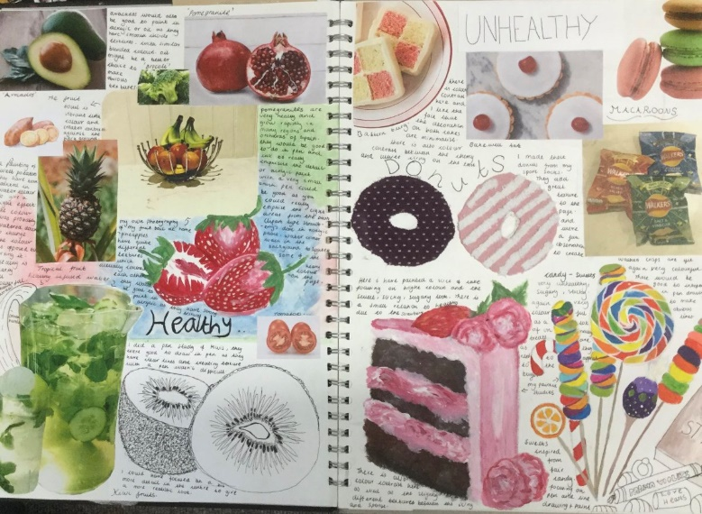
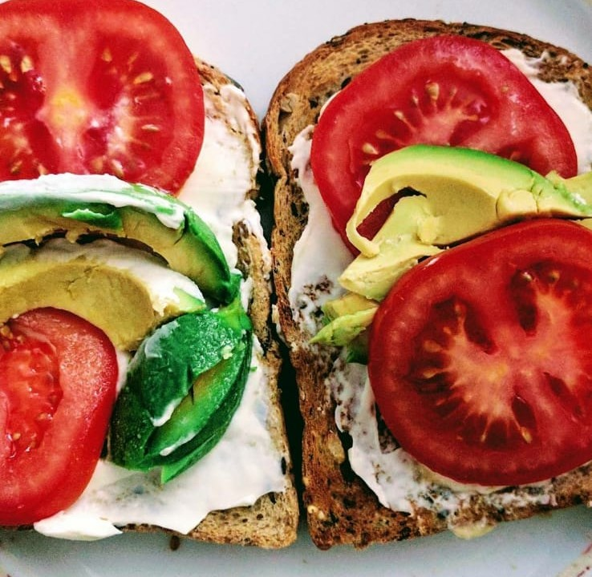
Year 10 Coursework Project: Food

Slide 11
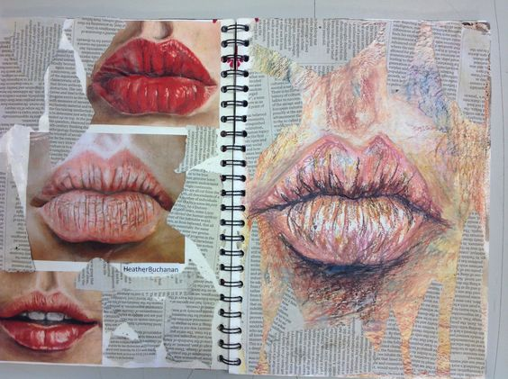
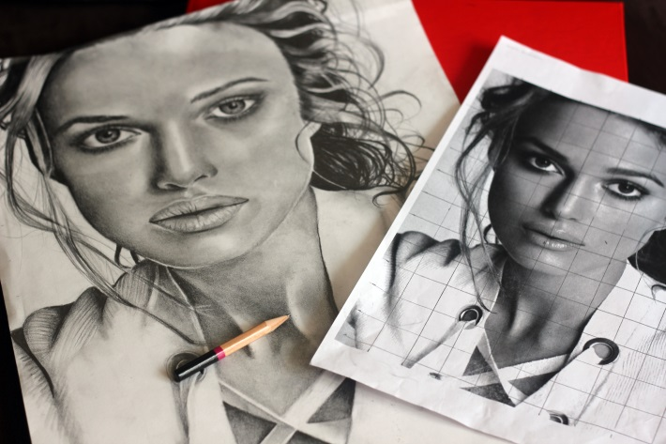
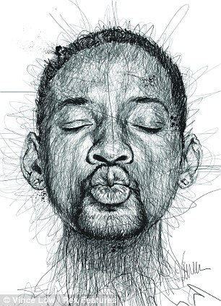
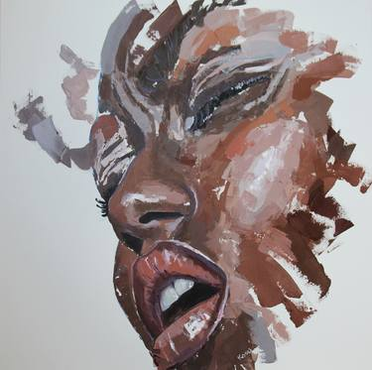
Year 10 Coursework Project: Identity

Slide 12
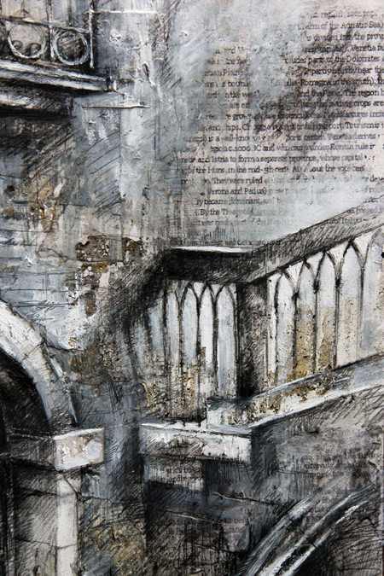
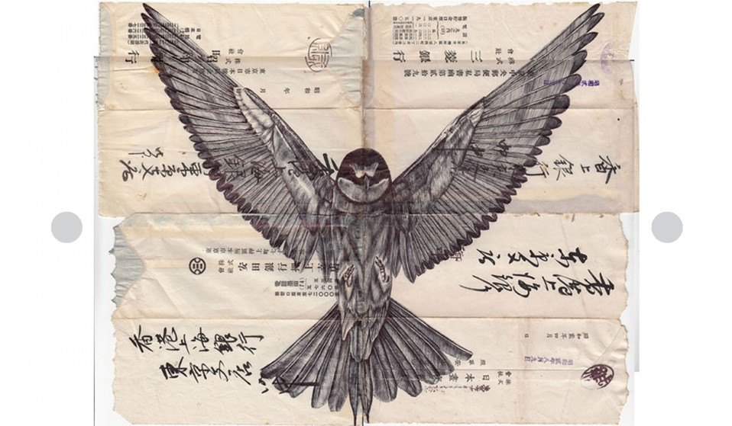
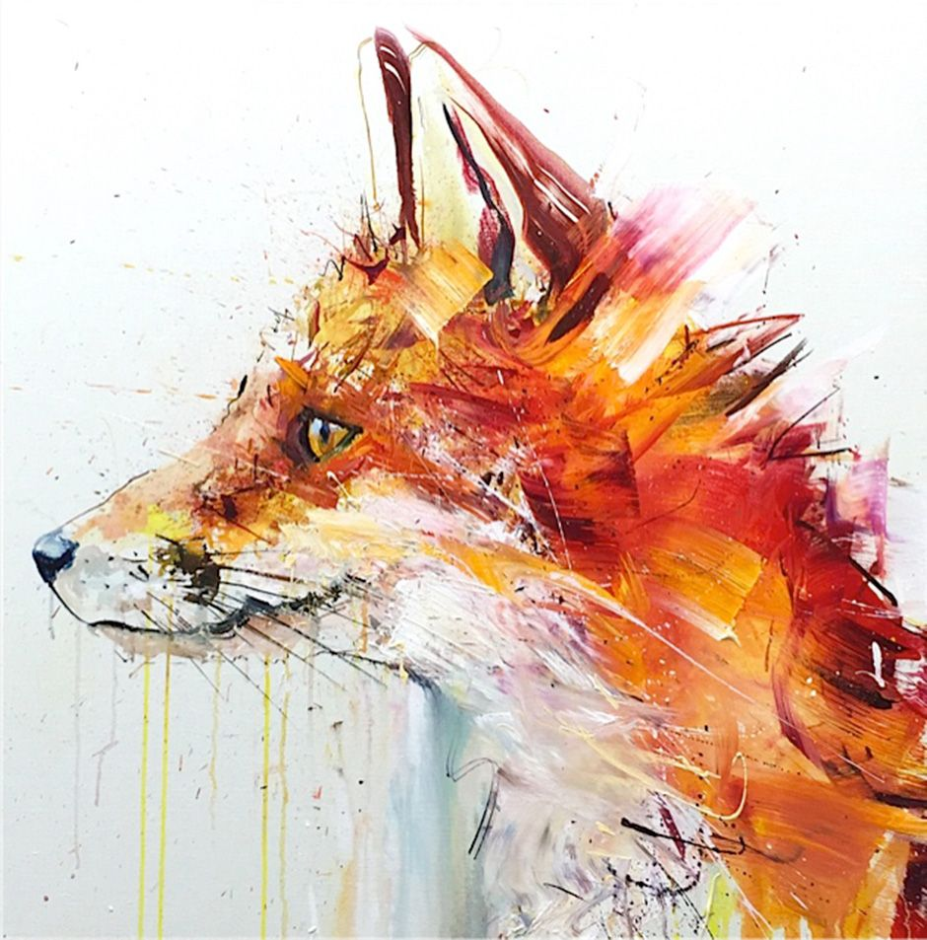
Year 11 Coursework Project – possible titles…
Expression
Light and Dark
The Natural World
Inside/Outside
Fantastic and Strange

Slide 13
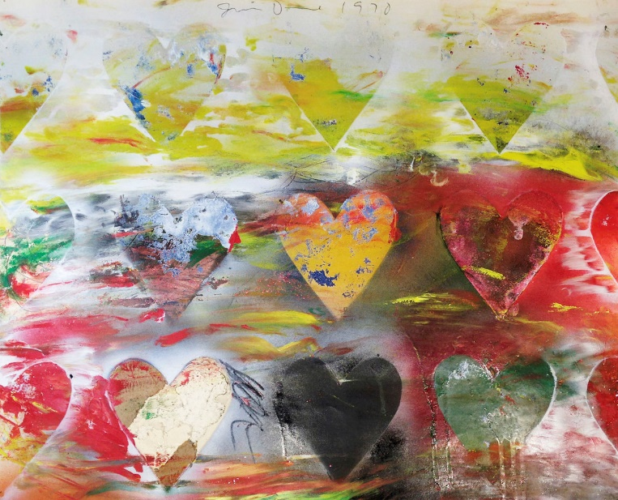
This is the course for you if…
You have a passion for art.
You are a creative person who wants to make things.
You like looking at the world around you and want to record it.
You want to develop your drawing, painting and making skills, and learn new art techniques.
You are open to new ideas about art.
You are able to reflect on your work, which will be done through annotated work in your sketchbooks.
You are interested in a career in the visual and creative arts industry.

