Slide 1
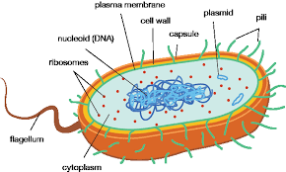
A LEVEL Biology
A level Biology provides a solid grounding in analytical thinking, writing reports and clear communication – all of which are useful life skills
By the end of the course you will know more about a range of topics including: Biological molecules, cell biology, exchange mechanisms, energy transfer, nervous control and homeostasis, ecology, inheritance and the control of genes.
Studying A level Biology can lead to careers
in medicine, care work, biomedical science, the emergency and uniformed services, healthcare, laboratory research and medical administration.
A Level Biology is a facilitating subject commonly asked for in university entry requirements.
A level Biology results are consistently strong.
The course is delivered by experienced, supportive teachers.
CAN I STUDY A LEVEL BIOLOGY?
Grade 6 GCSE Biology or 6-6 in GCSE Combined Science is required.
If you are consistently working at this grade or above, you should consider BIOLOGY

