Slide 1
BTEC Digital Information Technology

Slide 2
General Information
BTECs embody a fundamentally learner-centred approach to the curriculum, with a flexible, unit-based structure and knowledge applied in project-based assessments.
BTECs offer level 2 learners an engaging introduction to life and work in a vocational sector.
Students develop knowledge and understanding by applying their learning and skills in a work-related context.

Slide 3
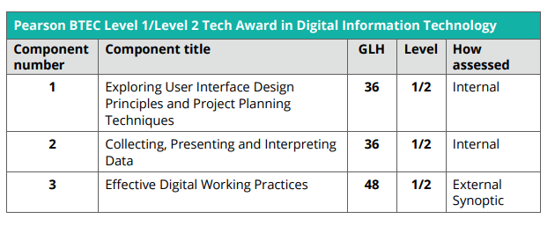
At a Glance, 120 GLH ..

Slide 4
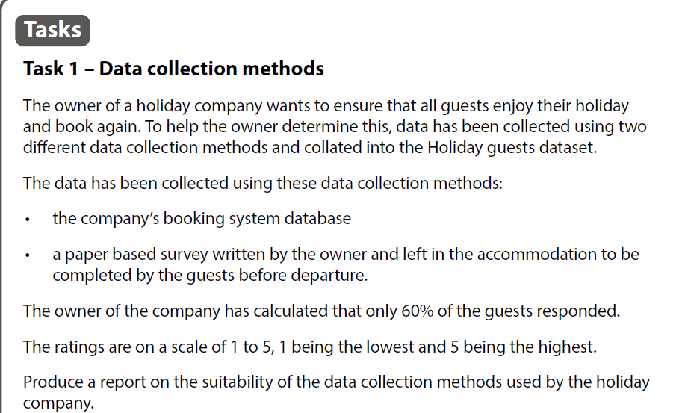
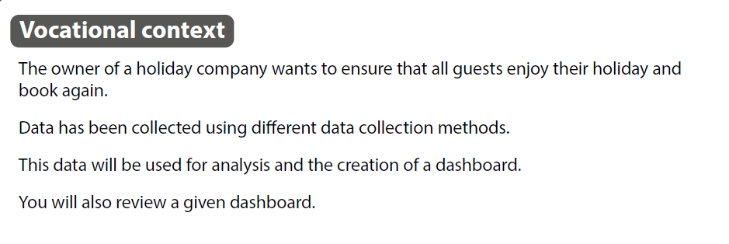
Unit 2: Portfolio 2 Example –

Slide 5
Why do BTEC ICT?
BTEC Nationals are widely recognised by industry and higher education as the signature vocational qualification.
Progression to:
academic qualifications, such as GCSE or GCE A Level in ICT or Computing.
employment within the information technology and/or areas within the creative industries, such as electronic publishing or multimedia production.

Slide 6
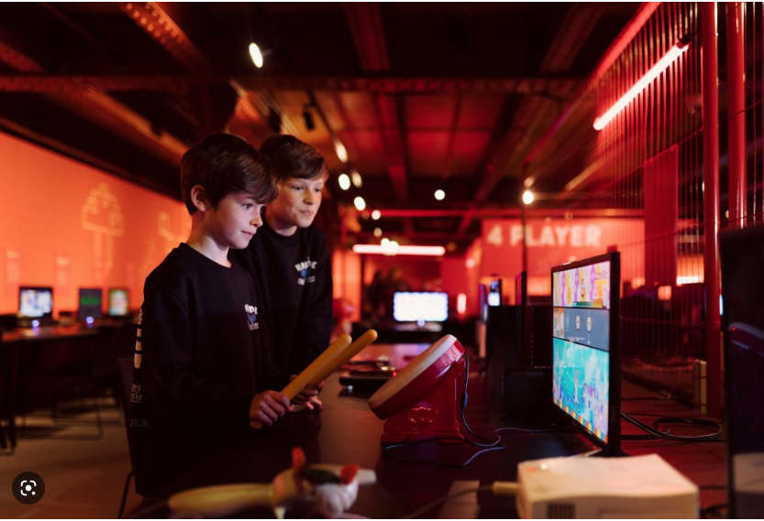
Trips!

Slide 7
I would recommend Btec IT Level 2 because
More and more jobs are utilising computers in order to increase efficiency of our whole society. A lack of computer understanding is therefore fatal to the millennial job-seeker. Furthermore, computers open up a whole world of mass communication, entertainment, knowledge, mathematics, literature, art and science- Information Technology is a world of wonder that one would be foolish not to consider exploring.
Hamish (Y11)

Slide 8
I would recommend BTEC IT Level 2 because
Most people have a computer(s) in the place where they live and in most jobs there is computer related tasks therefore a base level of skill using them is required
Oliver Y11

Slide 9
I would recommend Btec IT Level 2 because
“I would recommend Btec IT Level 2 because it helps you gain a wide range of skills such as: how to make a database, Photoshop skills and also things to help you get a job. Such as how make portfolio and how to write a cv.”
“The thing that I most enjoyed was learning how to design an interface myself step-by-step, which can be very useful in my working life.”
AidenY11

Slide 10
I would recommend Btec IT Level 2 because
I would recommend this course because it teaches you all of the basics of a computer and a computer systems but at the same time does go into detail about wires server back bones, it also highlights how it will be relevant and the advantages of certain areas to business, which will really help when applying for jobs in the future in around companies. It also teaches you about file protection and ensures that you are always safe online by teaching you about con tactics by cowboys.
It is certainly a course that I would do again because it was a really laid back course that has one exam and more course work which enables more cooperation and less pressure in the summer in year 11 because the exam has already been done in year 10.
Jack Y11

Slide 11
I would recommend Btec IT Level 2 because
It teaches you a variety of skill needed for jobs that use IT. These skills are easy to learn and can help you later on in life.
By Jaiden Y11

