Slide 1
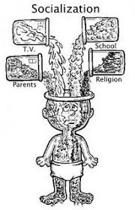
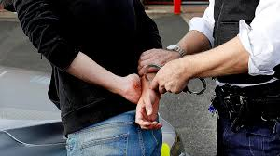
A LEVEL SOCIOLOGY
I FIND THE TOPICS WE STUDY RELEVANT, RELATABLE AND INTERESTING.
SOCIOLOGY HELPS ME TO UNDERSTAND THE WORLD AROUND ME AND PROVIDES EXPLANATIONS FOR HOW SOCIETY WORKS THE WAY IT DOES.
WHAT DO WE STUDY ?
YEAR 12 – SOCIALISATION, CULTURE AND IDENTITY
FAMILIES AND RELATIONSHIPS
RESEARCH METHODS AND SOCIAL INEQUALITIES
YEAR 13 – GLOBALISATION AND THE DIGITAL SOCIAL WORLD
CRIME AND DEVIANCE
YEAR 12 STUDENT
YEAR 13 STUDENT
ENTRY REQUIREMENTS
GRADE 4 IN ENGLISH
AN ENQUIRING MIND
INTERPRET DATA
EXTENDED WRITING SKILLS

