Slide 1
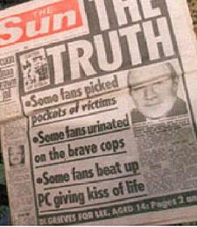
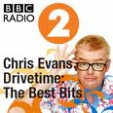
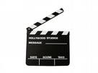
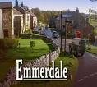
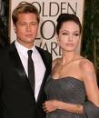
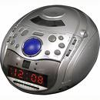
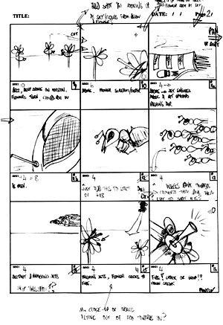
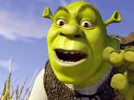
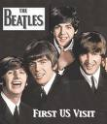
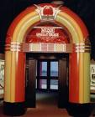
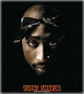
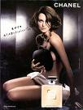
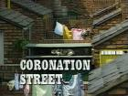
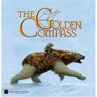
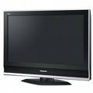
GCSE
MEDIA STUDIES at Abbeyfield

Slide 2
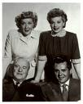
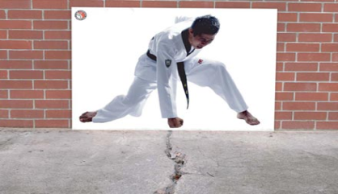
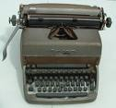
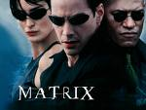
GCSE Media Studies is a new option available to you next year and it is EVEN more than just watching films...
How have sitcom families adapted in line with cultural changes in society?
How should artists sell their music in the era of streaming services?
What is the most effective advertising method, and how can advertising be ‘subliminal’?
How can a camera angle make us feel empathy with a character?
Is social media to blame for eating disorders and plastic surgery mania?
How has Manga influenced Western media texts?
Are newspapers outdated?
Is there such a thing as ‘alternative’ music?

Slide 3
Aims and Objectives
From Eduqas (the exam board):

Slide 4
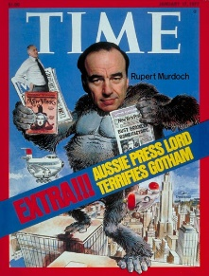
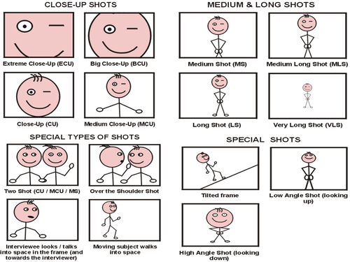
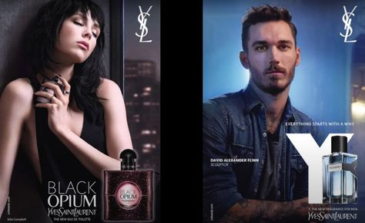
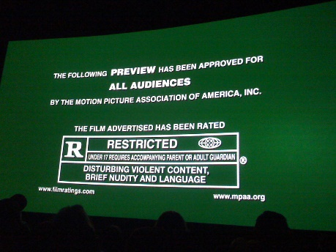
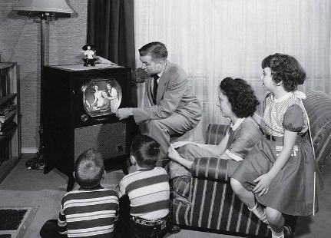
Media Industries
Representation
Media Language
What do you study in GCSE Media Studies?
Range of media forms and texts
Audiences
Advertising and marketing
Film
Magazines
Music videos
Online, social and participatory media
Newspapers
Radio
Television
Video games
Contexts

Slide 5
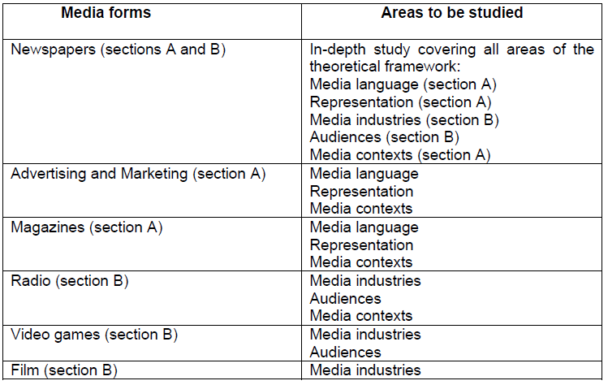
What do you study in GCSE Media Studies?
COMPONENT 1:

Slide 6
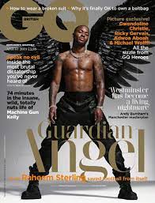
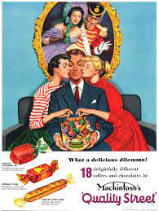
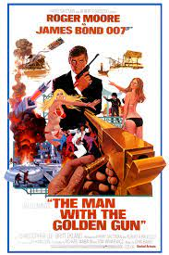
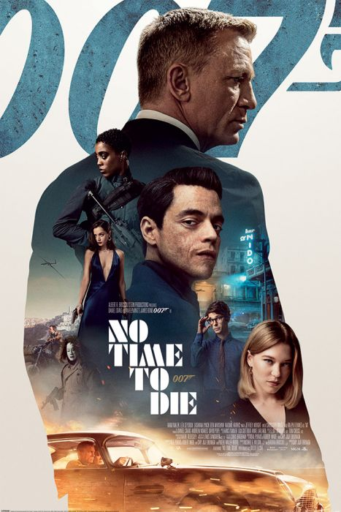
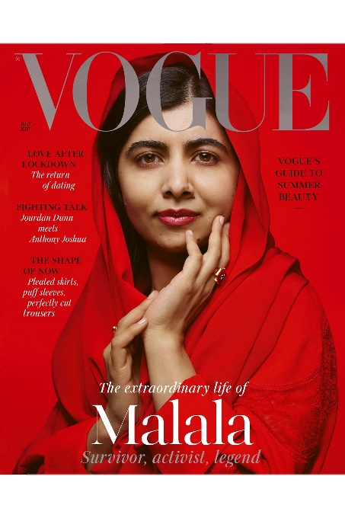
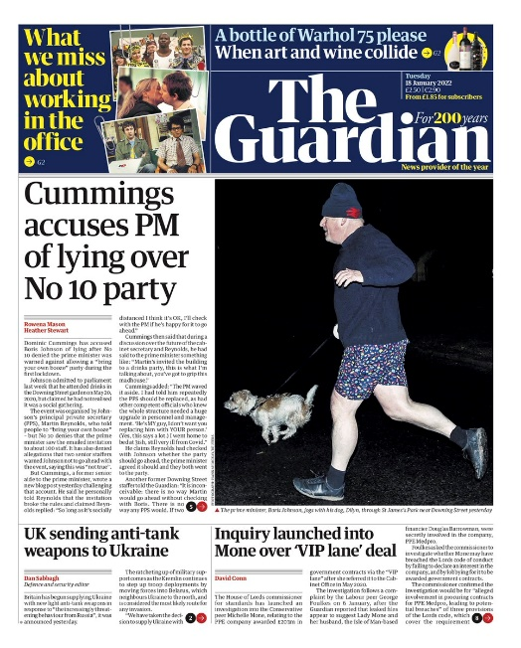
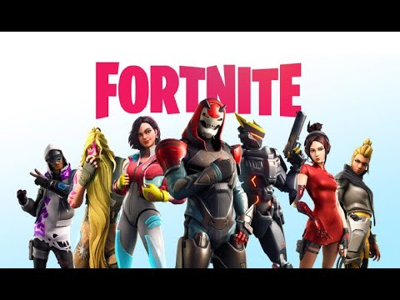
COMPONENT 1:

Slide 7
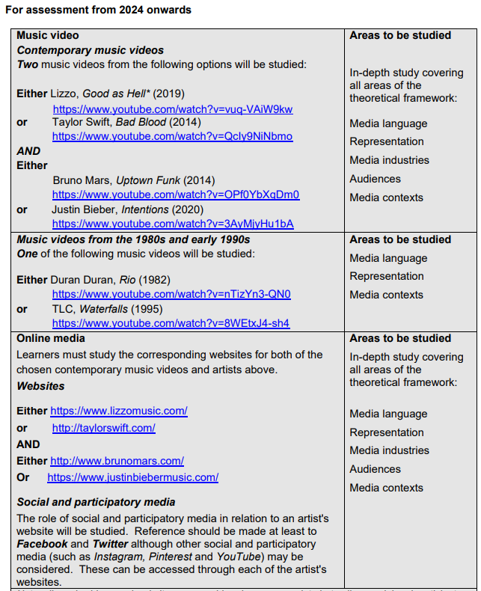
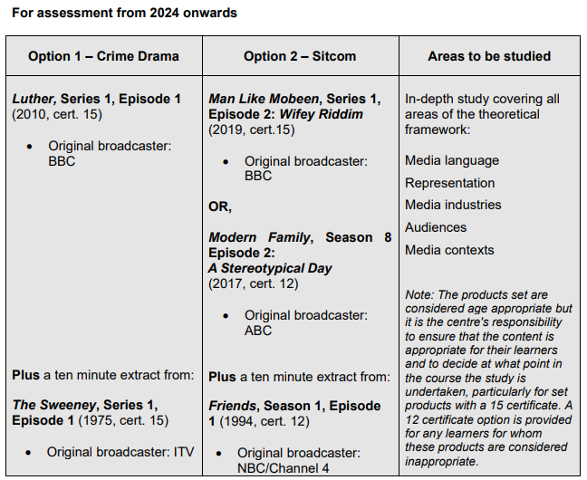
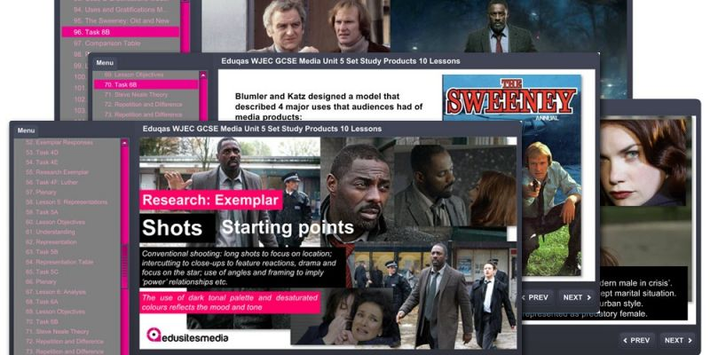
COMPONENT 2:

Slide 8
How are you assessed?
COURSEWORK
30%
12weeks max
EXAM 1
40%
1HR 30
EXAM 2
30%
1HR 30
e.g. TV/Film Marketing
(DVD & Poster)
- Statement of aims
- Research and planning
- Making the product
Section A
Media Language
Representation
Section B
Media Industries
Audiences
Section A
Television
Section B
Music

Slide 9
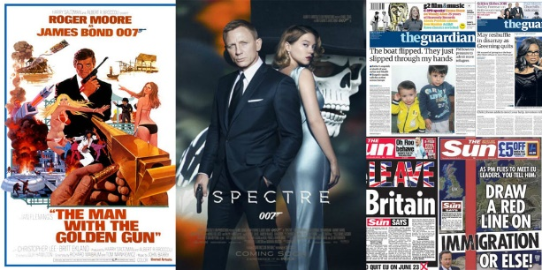
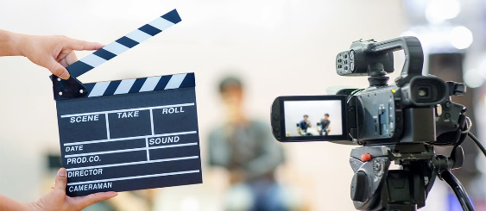
How are you assessed?
2 exams
1.5 hours each
70% of GCSE
Revised and unseen material
Analytical (answering questions on set topics)
Component 1: magazine front covers e.g. Pride and GQ, film marketing posters e.g. Bond films, newspaper front pages e.g. The Guardian and The Sun, print advertisements for different products
Component 2: in-depth study of television (crime drama or sitcom) and music (music videos and related online media)
Coursework
Your own media production
30% of GCSE
Project over 12 weeks
Creative, supported
A sequence from a new television programme OR a website to promote it OR
A music video or a website to promote a new artist/band OR
Print-based marketing material for a new film OR
A new print or online magazine

Slide 10
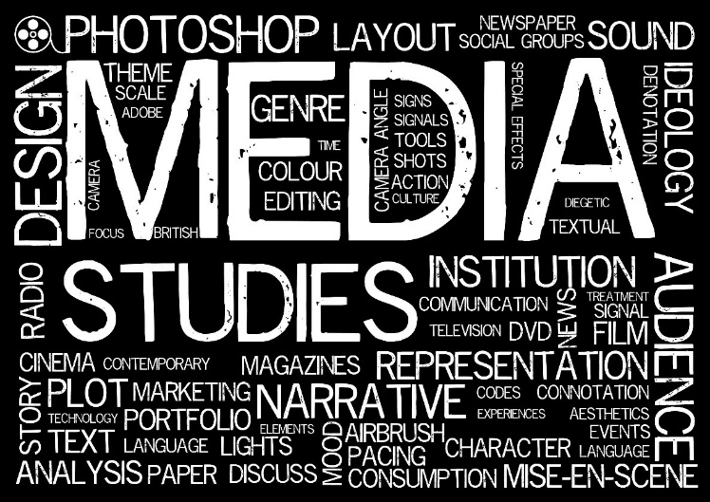
Is it for you?
The average adult consumes media for almost 8 hours a day…How someone responds to the media they consume will affect their ideas about people, places, society, politics, culture, themselves and their place in the world! Sound like something you’d like to understand better?!
Skills Involved
Critical thinking
Analysis
Research
Creativity
Planning
Practical skills
Time management
Essay writing skills
Team work
Presentation skills
Where could it take you?
Further study in Media Studies, Film, Humanities, Social Sciences, Communications, Cultural Studies
Media industry jobs: TV and film production, advertising, journalism, interactive media, digital marketing, technical production, special effects, web design, post-production

Slide 11
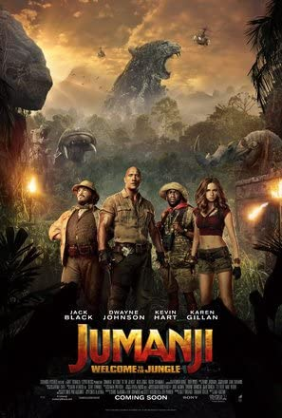
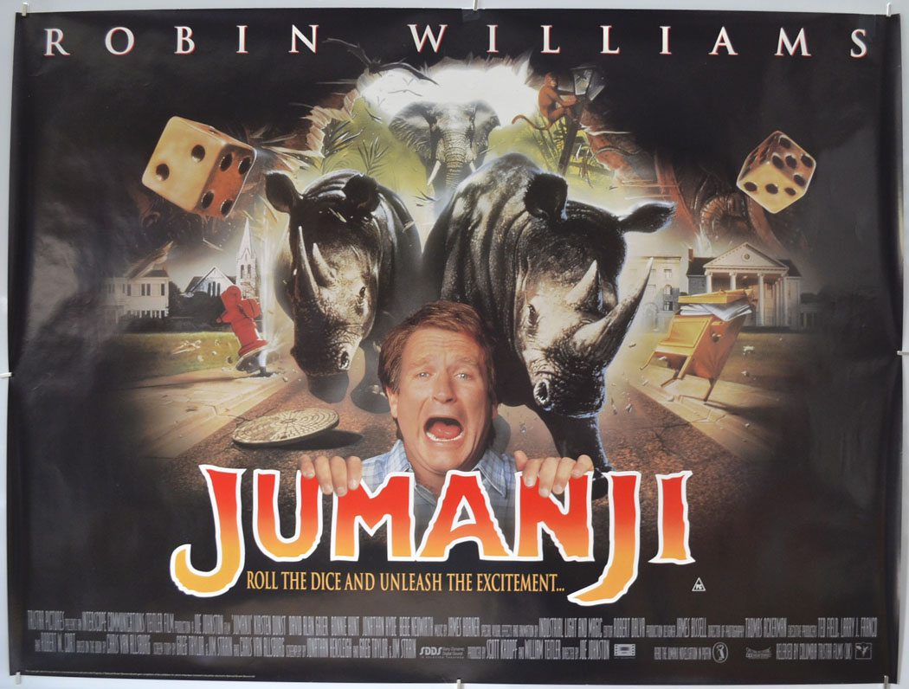
Typical lesson content…
What does this wide range of posters tell you about how films are promoted? I.e. why are there varied posters to promote the same film?
Do these alternative promotional posters change your thinking or add anything else to your expectations?

Slide 12
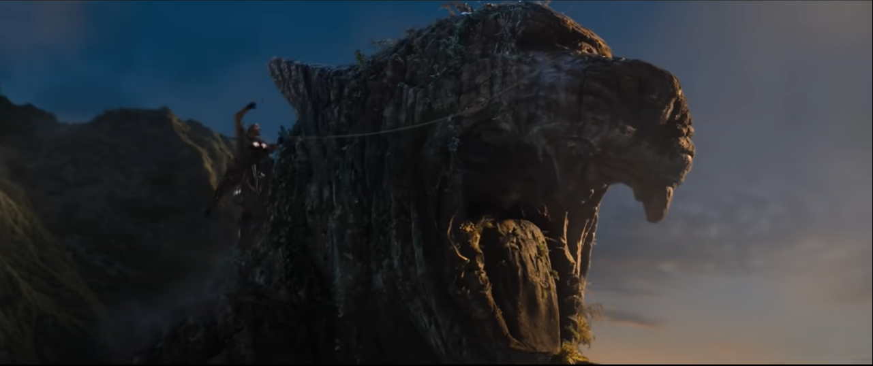
Typical lesson content…
Can you put it all together?
How is a sense of danger created in this scene from Jumanji: Welcome to the Jungle?
Complete your ideas in note form in your table.
Mise-en-scene feature | Observations from scene
Setting and props
Costume and make-up
Actions – expressions, gesture codes, movement
Lighting and use of colour
Positioning of objects and people
Camera shots
The director uses a range of different camera shots in the opening of this scene to create a sense of danger and tension as the character picks her way through a mass of writhing snakes. In particular, the use of the high angle crane shots show the character surrounded by these dangerous snakes and without a clear path to safety. The camera acts as the eyes of the audience and we can see the danger she’s in, we want her to succeed, but we are powerless to help her…
Notes:
https://www.youtube.com/watch?v=iKduvC0uNs8

Slide 13
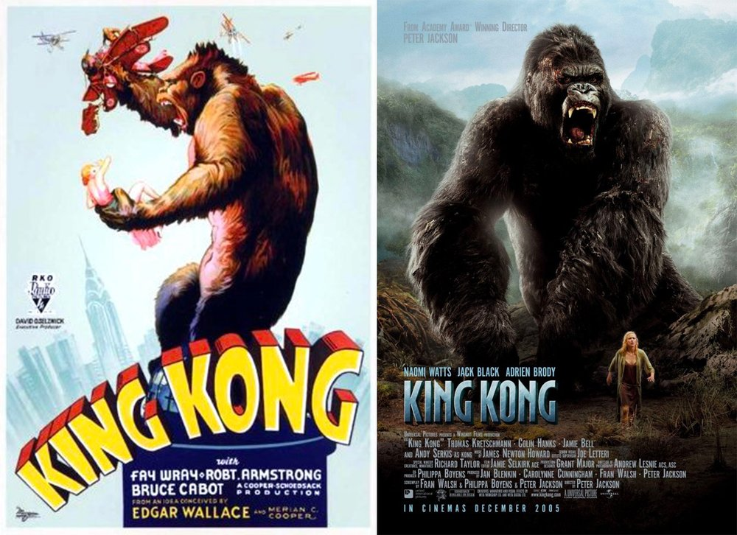
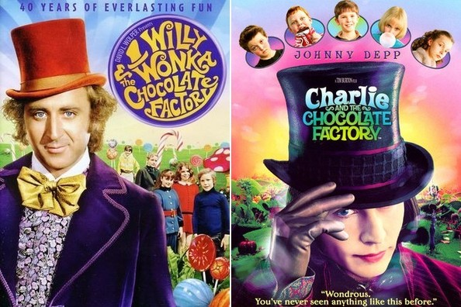
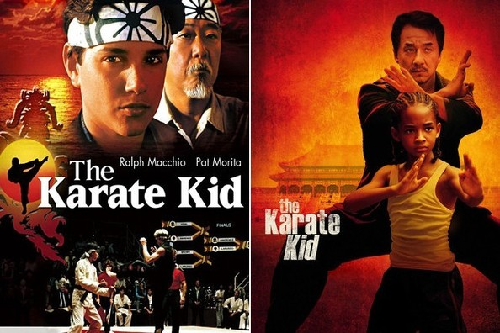
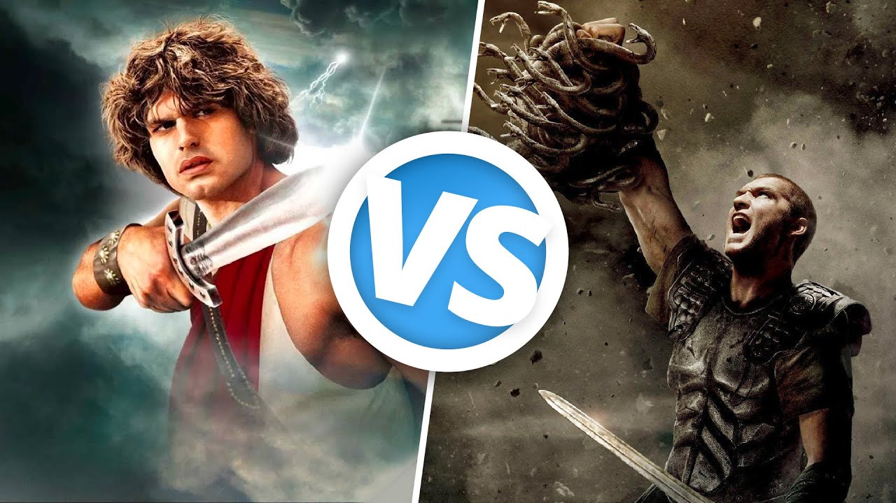
‘Sequel’/’remake’/’continuation’/’influenced by’… What are the pros and cons of making a new version of a film?

Slide 14
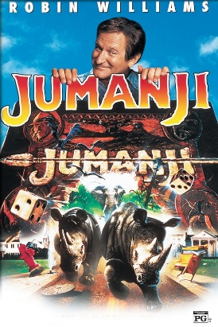
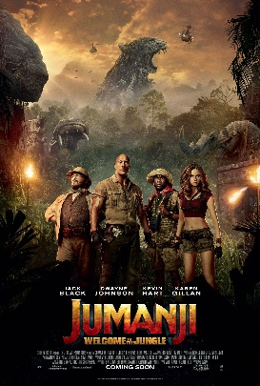
As we watch the trailers for the two Jumanji films, record any similarities and differences you notice.
Similarities
Differences
Notes:
https://www.youtube.com/watch?v=veszTagaXik (1995)
https://www.youtube.com/watch?v=2QKg5SZ_35I (2017)

Slide 15
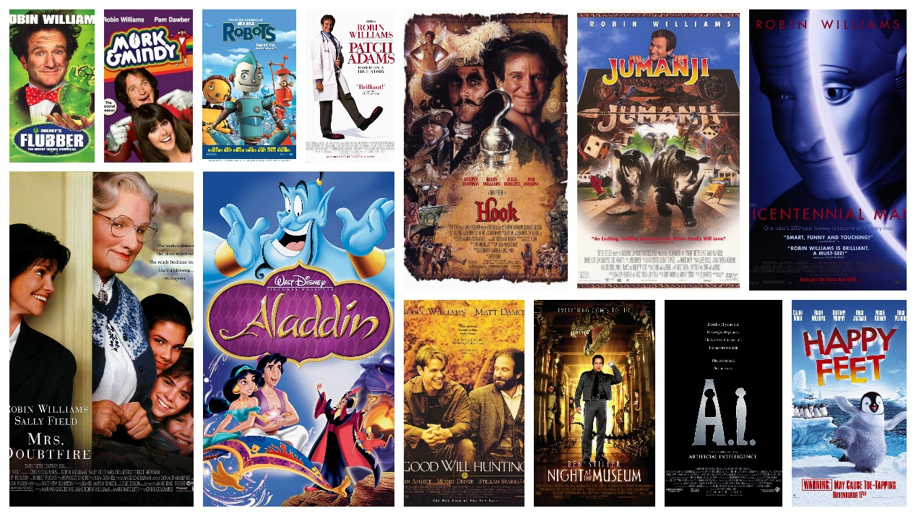
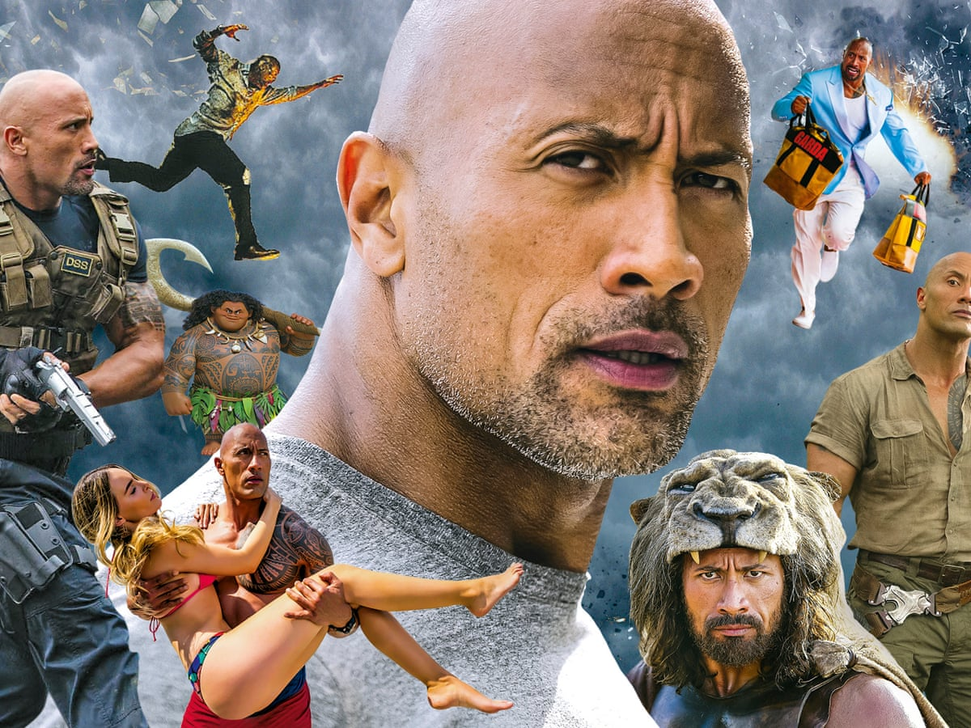
BOX OFFICE DRAW = the significant star appeal of the main cast/actor in a film. Often, the casting choices can be something that ensures a ‘box office hit’ and is usually the feature which indicates both the genre and target audience of a film.
What do the filmographies of these stars lead you to expect in terms of the genre and target audiences of the Jumanji films?

Slide 16
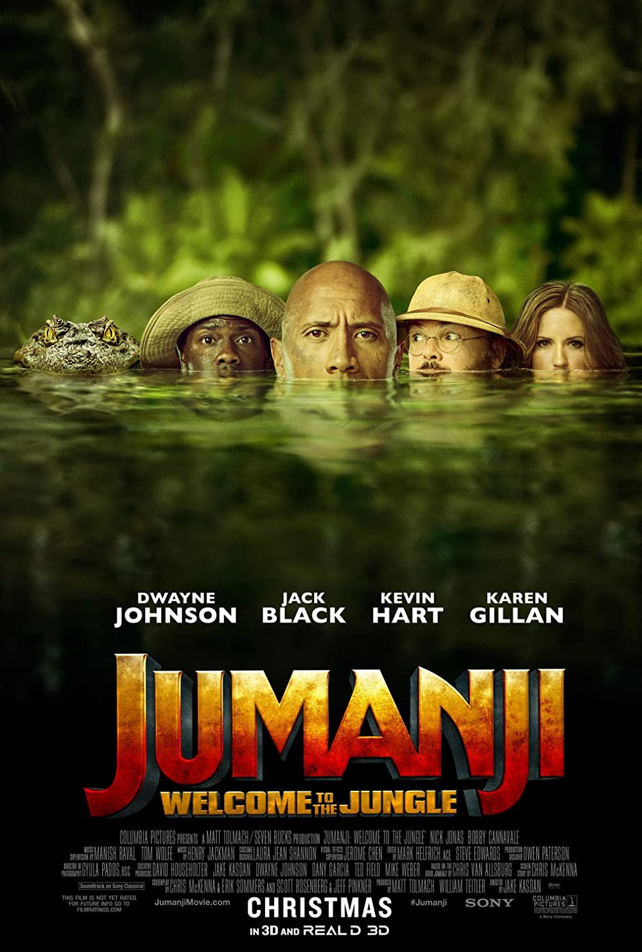
What changes would you make if you were producing a remake of Jumanji as a HORROR or ROMANCE genre film?
Think about:
Genre conventions of horror or romance
Casting choices
Mise-en-scene signifiers
Marketing materials (promotional posters, trailers etc.)
Target audiences
Present your ideas either in the form of a production (a new poster or trailer/scene storyboard) or written proposal.

Slide 17
Developing further…
What does the choice of casting for the male role reveal about changes in representation of masculinity?
What is a hybrid genre and how does this ensure wider audience appeal?
What does ‘typecast’ mean and can an actor subvert expectations?
How are changes in the industry impacting box office success e.g. the growth of streaming services as modes of producing, marketing and consuming film?

Slide 18
If you have any further questions, please do get in touch:
jmp@abbeyfield.sch.uk

