Slide 1
GCSE Business
Teachers:
Mr Stewart
Mrs Meade

Slide 2
Units you will cover:
Business in the real world
Influences on Business
Business Operations
Human Resources
Marketing
Finance

Slide 3
Business in the real world
Sole trader
Business Plan
Franchise
Expanding a Business
Stakeholders
Location

Slide 4
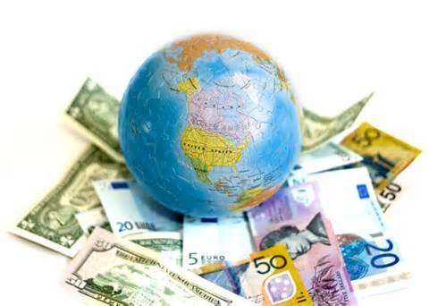
Influences On Business
Interest rates
Exchange rates
The environment
Ethics
The business cycle

Slide 5
Operations
Supply Chains
Quality
Customer Service
Production Methods

Slide 6
Human Resources
What motivates you
How do you motivate people to work for you
How to recruit people to work for you
How to get a job

Slide 7
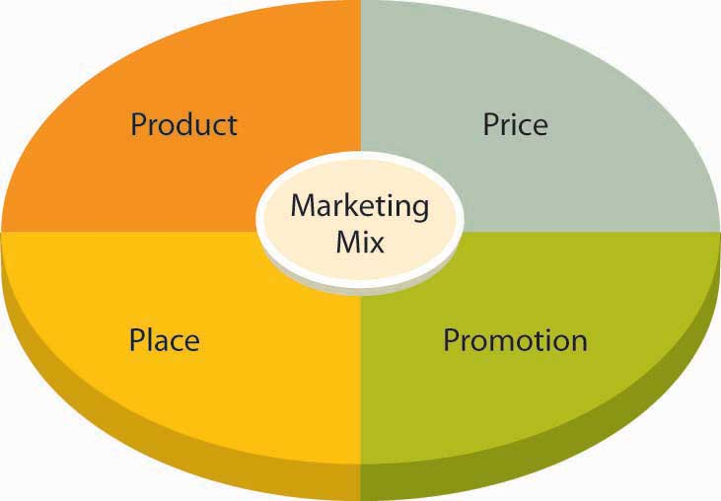
Marketing
Market Research
Product Portfolio
Marketing Mix

Slide 8
Finance
What finance is available for businesses?
How to manage your businesses money?
Produce a cash flow statement
Work out profit
Work out how to break-even

Slide 9
Charlotte – Aged 25 says:
I did Business Studies and carried it through to degree. I did this because I had no idea what I wanted to do and figured that wherever I worked it was likely to be a business.
It enabled me to easily move onto studying CIMA (management accountancy) and provides an ideal background to switch careers.

Slide 10
What do current students say?
Good GCSE that has helped me get into 6th form to do Business, Maths and Sport
Get to develop my understanding of the Business world
The subject is not all theory – get to do a lot of activities and mini projects
Helps get a job or an apprenticeship

Slide 11
What do current students say?
It’s not just about Business you learn life and team work skills
Helps you understand how to start up your own business
Learn about finance, marketing and the real business world
Helps you be more mature and think about your future

Slide 12
Where to find us…
If you have any questions we are in the IT office next to the IT rooms.
We look forward to seeing you in September!!

